Slide 1

‘Giving it away’, not ‘no pay’
Elliott Bledsoe
Project Officer, Creative Commons Australia
Notes:
‘GIVING IT AWAY’ NOT ‘NO PAY’
Hello. I’m Elliott Bledsoe, a Project Officer with Creative Commons Australia and Research Assistant with the ARC Centre of Excellence for Creative Industries and Innovation.

Slide 2

Except where otherwise noted, this presentation is available under a Creative Commons Attribution 2.5 Australia licence. Full terms at http://creativecommons.org/licenses/by/2.5/au
Notes:
FRONTISPIECE – LICENCE
Before I begin, please be aware that this presentation is available under a Creative Commons Attribution 2.5 Australia licence.
Badge: The CC Attribution notification badge by Creative Commons Corporation. Available under a Creative Commons Attribution 3.0 Unported licence. Full terms are available at http:// creativecommons.org/licenses/by/3.0. This badge is available for reuse in accordance with the Creative Commons trademark policy available at http:// creativecommons.org/presskit.

Slide 3

Notes:
FRONTISPIECE – LICENCE
This means you are free to
Icons: The Pink CC icon is a derivative work of the CC logo by Creative Commons Corporation. The original logo is available under a Creative Commons Attribution 3.0 Unported licence. Full terms are available at http:// creativecommons.org/licenses/by/3.0. The original logo is available for reuse in accordance with the Creative Commons trademark policy available at http:// creativecommons.org/presskit. The Pink CC icon by Elliott Bledsoe is available under a Creative Commons Attribution 2.5 Australia licence. Full terms are available at http:// creativecommons.org/licenses/by/2.5/au

Slide 4

Share
Notes:
FRONTISPIECE – LICENCE
share this presentation; you can copy, distribute and transmit the work; and you are free to
Icons: The Pink CC icon is a derivative work of the CC logo by Creative Commons Corporation. The Pink Share icon is a derivative works of the Share freedom icon by Creative Commons Corporation. The original logo and freedom icon are available under a Creative Commons Attribution 3.0 Unported licence. Full terms are available at http:// creativecommons.org/licenses/by/3.0. The original logo and the freedom icon are available for reuse in accordance with the Creative Commons trademark policy available at http:// creativecommons.org/presskit. The Pink CC icon are the Pink Share icon by Elliott Bledsoe are available under a Creative Commons Attribution 2.5 Australia licence. Full terms are available at http:// creativecommons.org/licenses/by/2.5/au

Slide 5

Share
Remix
Notes:
FRONTISPIECE – LICENCE
remix it; to adapt and build onto this presentation; even commercially.
Icons: The Pink CC icon is a derivative work of the CC logo by Creative Commons Corporation. The Pink Share icon and the Pink Remix icon are derivative works of the Share freedom icon and the Remix freedom icon by Creative Commons Corporation. The original logo and freedom icons are available under a Creative Commons Attribution 3.0 Unported licence. Full terms are available at http:// creativecommons.org/licenses/by/3.0. These icons are available for reuse in accordance with the Creative Commons trademark policy available at http:// creativecommons.org/presskit. The Pink CC icon are the Pink Share icon by Elliott Bledsoe are available under a Creative Commons Attribution 2.5 Australia licence. Full terms are available at http:// creativecommons.org/licenses/by/2.5/au

Slide 6
7 case studies
Notes:
INTRODUCTION
- 7 case studies
This evening I am here to tell you 7 stories.

Slide 7
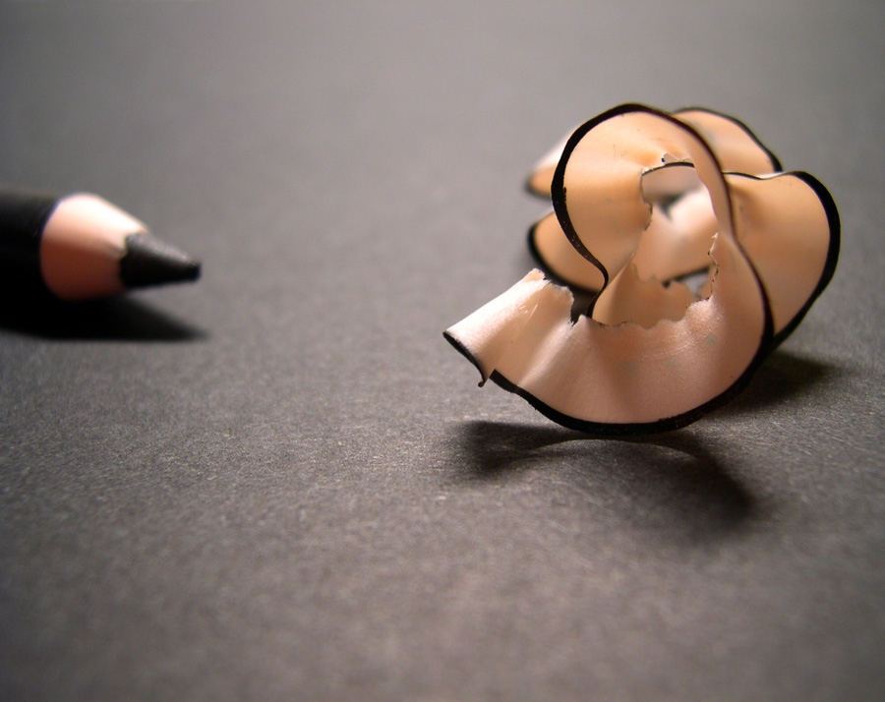
literature
Notes:
LITERATURE
Literature has long been thought of as the last bastion of the copyright conservatives. But new projects and new approaches to rights management within the publishing sector as emerging. So let’s start with literature.
Photo: | black | by arquera, http://www.flickr.com/photos/puntodevista/114155928. Available under a Creative Commons Attribution 2.0 Generic licence. Full terms available at http://creativecommons.org/licenses/by/2.0

Slide 8
Notes:
LITERATURE – ADUKI PRESS
- Melbourne-based small press
Aduki Independent Press is a small press based in Melbourne who publish non-fiction books, essays and magazines. Their catalogue orientates itself around social issues, politics, travel and vegan and vegetarian cuisine.

Slide 9

Notes:
LITERATURE – ADUKI PRESS – STICK THIS IN YOUR MEMORY HOLE
- published Stick this in your memory hole on 1 November 2007
- work of first-time author Tristan Clark
- on contemporary Australian politics
- title references Orwell’s 1984, ‘memory hole’ was a disposal shoot through which documents deemed to be in conflict with ‘official truths’ were sent
- physical and PDF formats available under a CC licence
Late last year Aduki published first-time author Tristan Clark’s witty and critical take on contemporary Australian politics, Stick this in your memory hole.
For all the importance of the author’s ideas, there were a number of factors that could diminish the book’s impact: Tristan Clark is an emerging writer on politics; publishing in an field where there is much literature and a tendency for dominance by ‘superstar’ commentators; it was his first book; which was published by a small, independent press; and it was launched in the middle of the 2007 Australian Federal Election.
The title is a reference to George Orwell’s 1984, with the ‘memory hole’ being a disposal shoot through which documents deemed to be in conflict with ‘official truths’ were sent. To help ensure that the 37 essay-chapters of the book wouldn’t similarly disappear into Orwell’s memory hole, the author and the publisher decided to release Stick this in your memory hole under a Creative Commons licence. The physical volume and a digital PDF format are both available under a
Cover: Stick this in your memory hole by Tristan Clark, http://www.aduki.net.au/component/page,shop.product_details/flypage,shop.flypage/product_id,30/category_id,7/manufacturer_id,0/option,com_virtuemart/Itemid,35/vmcchk,1/. Available under a Creative Commons Attribution-Noncommercial 2.5 Australia licence. Full terms available at http://creativecommons.org/licenses/by/2.0

Slide 10


Notes:
LITERATURE – ADUKI PRESS – STICK THIS IN YOUR MEMORY HOLE
- available under a Creative Commons Attribution-Noncommercial 2.5 Australia licence
- Emily Clark quote
Creative Commons Attribution-Noncommercial 2.5 Australia licence. As Aduki’s manager Emily Clark, explained:
‘We really like the idea of giving people easy access and the right to use the work without seeking our permission as the book has an important message that needs to be shared.’
She went on to say:
‘The content of the book, I feel, is really important and needs to be shared. The author and I did not want to limit access to the book to those who could afford a print copy. We also hoped the work would be shared and reference and wanted the audience to know that they were able to do that without contacting us.’
In April this year the book had been
Cover: Stick this in your memory hole by Tristan Clark, http://www.aduki.net.au/component/page,shop.product_details/flypage,shop.flypage/product_id,30/category_id,7/manufacturer_id,0/option,com_virtuemart/Itemid,35/vmcchk,1/. Available under a Creative Commons Attribution-Noncommercial 2.5 Australia licence. Full terms available at http://creativecommons.org/licenses/by/2.0
Icons: The Pink CC icon is a derivative work of the CC logo by Creative Commons Corporation. The Pink Attribution icon and the Pink Noncommercial icon are derivative works of the Attribution element icon and the Noncommercial element icon by Creative Commons Corporation. The original logo and element icons are available under a Creative Commons Attribution 3.0 Unported licence. Full terms are available at http:// creativecommons.org/licenses/by/3.0. The original logo and element icons are available for reuse in accordance with the Creative Commons trademark policy available at http:// creativecommons.org/presskit. The Pink CC icon, the Pink Attribution icon and the Pink Noncommercial icon by Elliott Bledsoe are available under a Creative Commons Attribution 2.5 Australia licence. Full terms are available at http:// creativecommons.org/licenses/by/2.5/au

Slide 11
1000+ downloads
Notes:
LITERATURE – ADUKI PRESS – STICK THIS IN YOUR MEMORY HOLE
- 1000+ downloads
downloaded more than 1000 times and has sold

Slide 12
500+ sales
Notes:
LITERATURE – ADUKI PRESS – STICK THIS IN YOUR MEMORY HOLE
- 500+ book sales
more than 500 copies.
It is not only the first book from Aduki under a Creative Commons licence, but it is believed to also be the first title in Australia to be distributed by a publisher under CC. Recently, Aduki have expressed an intention to release Tristan Clark’s forthcoming second book under a Creative Commons licence as well. Keen an eye out for it early next year.

Slide 13
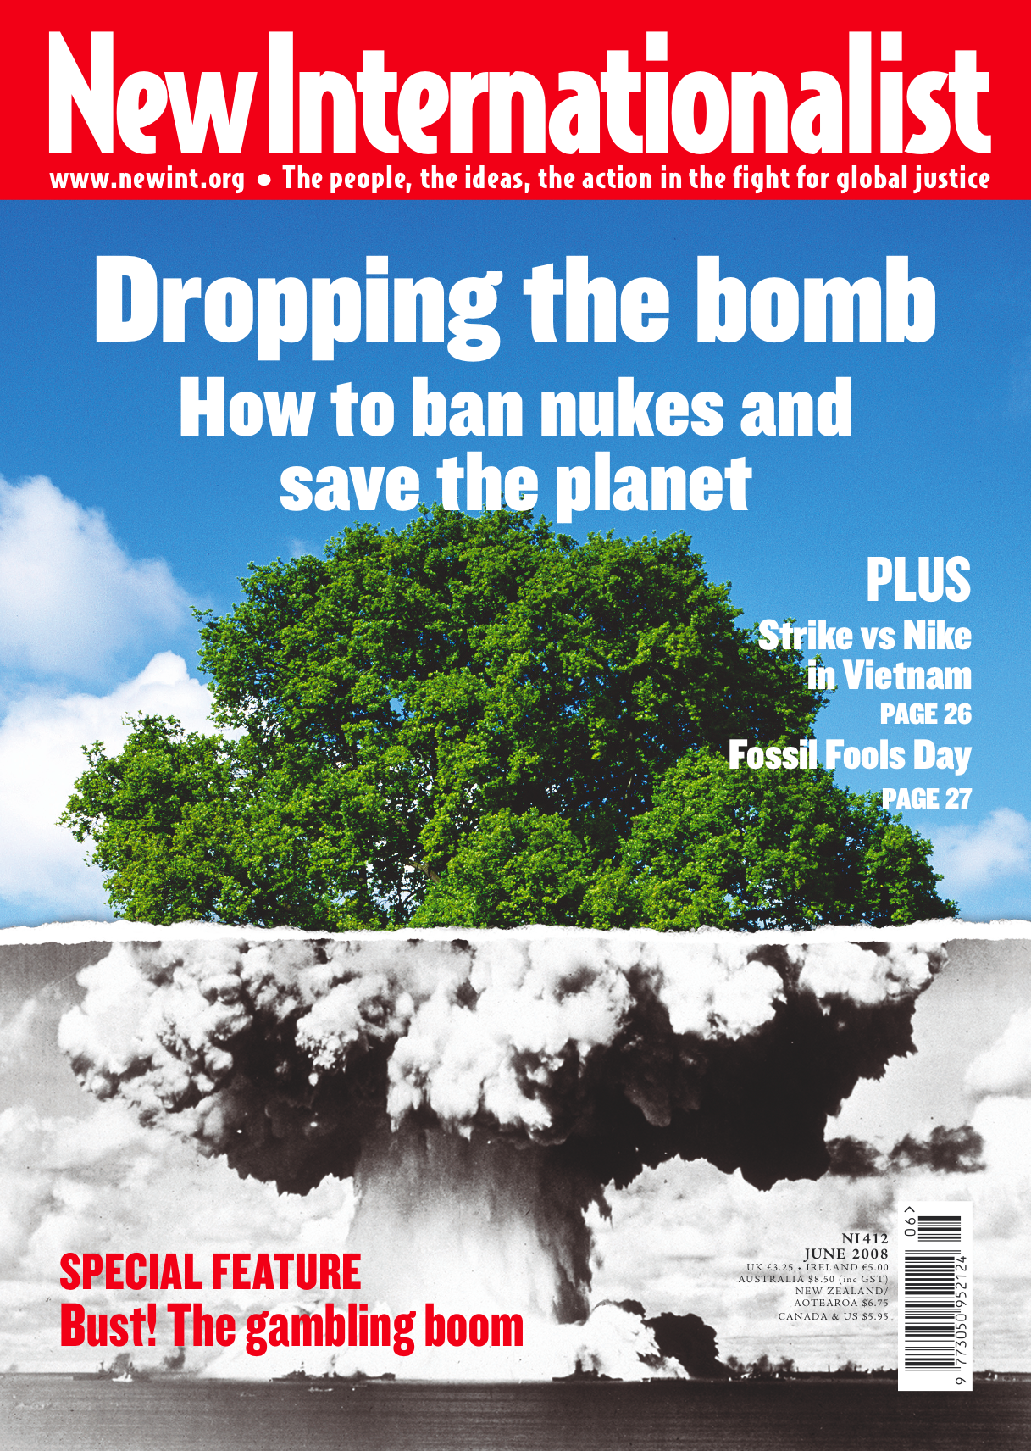
Notes:
LITERATURE – NEW INTERNATIONALIST
- monthly print magazine
- focused on social justice and human rights
New Internationalist is a monthly, guest-edited magazine produced by co-operative run publisher New Internationalist Publications from Oxford, England. It publishes content relating to social justice and human rights.
Along with the numerous films, books and other materials for various United Nations and related bodies concerned with world development, New Internationalist Publications also publishes the
Cover: New Internationalist, Issue 412, June 2008, http://www.newint.org/issues/2008/06/01/. © New Internationalist Publications. Used with permission.

Slide 14
Notes:
LITERATURE – NEW INTERNATIONALIST
- website with some republished content
- content published on the New Internationalist site is licensed under a CC BY NC ND 2.5 licence
New Internationalist website at www.newint.org.
In order to maintain its mission, NI values ‘self-help, responsibility, democracy, equality, equity and solidarity’. The release of materials under Creative Commons licences conforms to its ethos of openness and democratic participation: as stated, NI exists to ‘inform, education and communicate its message and ideals in an accessible style through the New Internationalist magazine, books, internet and other media.’
content published on the New Internationalist site is licensed under a CC BY NC ND 2.5 licence.
Website: New Internationalist by New Internationalist Publications. Unless otherwise noted, available under a Creative Commons Attribution-Noncommercial-No Derivative Works 2.5 Generic licence. Full terms available at http://creativecommons.org/licenses/by-nc-nd/2.5

Slide 15
Notes:
LITERATURE – NEW INTERNATIONALIST
- magazine is all rights reserved copyright
New Internationalist Publications reserves
Cover: New Internationalist, Issue 412, June 2008, http://www.newint.org/issues/2008/06/01/. © New Internationalist Publications. Used with permission.
Website: New Internationalist by New Internationalist Publications. Unless otherwise noted, available under a Creative Commons Attribution-Noncommercial-No Derivative Works 2.5 Generic licence. Full terms available at http://creativecommons.org/licenses/by-nc-nd/2.

Slide 16

Notes:
LITERATURE – NEW INTERNATIONALIST
- magazine is all rights reserved copyright
all the rights in the physical magazine, but republishes
Cover: New Internationalist, Issue 412, June 2008, http://www.newint.org/issues/2008/06/01/. © New Internationalist Publications. Used with permission.
Website: New Internationalist by New Internationalist Publications. Unless otherwise noted, available under a Creative Commons Attribution-Noncommercial-No Derivative Works 2.5 Generic licence. Full terms available at http://creativecommons.org/licenses/by-nc-nd/2.5
Icons: The Green Copyright logo is a derivative work of the CC logo by Creative Commons Corporation. The original CC logo is available under a Creative Commons Attribution 3.0 Unported licence. Full terms are available at http:// creativecommons.org/licenses/by/3.0. The original logo is available for reuse in accordance with the Creative Commons trademark policy available at http:// creativecommons.org/presskit. The Green Copyright logo by Elliott Bledsoe is available under a Creative Commons Attribution 2.5 Australia licence. Full terms are available at http:// creativecommons.org/licenses/by/2.5/au

Slide 17

Notes:
LITERATURE – NEW INTERNATIONALIST
- some content republished on website
- website licensed under CC BY-NC-ND 2.5 Generic
a selection of the content in the magazine on www.newint.org under a Creative Commons Attribution-Noncommercial-No Derivative Works 2.5 Generic licence. For the publisher, this supports their ethos of openness and democratic participation, while not undermining their business model.
And while we’re talking about money, financials also impact the publisher’s decision to use Creative Commons in another way. Although photographic content used in the print magazine are often sourced through agencies, the cost to obtain digital rights to the same images is often too high. So New Internationalist Publications source images from Yahoo’s photo publishing website Flickr.
Cover: New Internationalist, Issue 412, June 2008, http://www.newint.org/issues/2008/06/01/. © New Internationalist Publications. Used with permission.
Website: New Internationalist by New Internationalist Publications. Unless otherwise noted, available under a Creative Commons Attribution-Noncommercial-No Derivative Works 2.5 Generic licence. Full terms available at http://creativecommons.org/licenses/by-nc-nd/2.5
Icons: The Green Copyright logo and the Pink CC logo are derivative works of the CC logo by Creative Commons Corporation. The Pink Attribution icon, the Pink Noncommercial icon and the Pink No Derivative Works icon are derivative works of the Attribution element icon, the Noncommercial element icon and the No Derivative Works element icon by Creative Commons Corporation. The original logo and element icons are available under a Creative Commons Attribution 3.0 Unported licence. Full terms are available at http:// creativecommons.org/licenses/by/3.0. The original logo and element icons are available for reuse in accordance with the Creative Commons trademark policy available at http:// creativecommons.org/presskit. The Green Copyright logo, the Pink CC logo, the Pink Attribution icon, the Pink Noncommercial icon and the Pink No Derivative Works icon by Elliott Bledsoe are available under a Creative Commons Attribution 2.5 Australia licence. Full terms are available at http:// creativecommons.org/licenses/by/2.5/au

Slide 18

Notes:
LITERATURE – NEW INTERNATIONALIST – FLICKR IMAGES
- photo of South African President Thabo Mbeki
Such as this photo, accompanying a ‘Worldbeaters’ column on former South African President Thabo Mbeki. The photo, taken by Eric Miller, is made available on Flickr by the World Economic Forum under a Creative Commons Attribution-Share Alike 2.0 Generic licence.
Photo: Taken by Eric Miller. Available as Thabo Mbeki - World Economic Forum on Africa 2008 by World Economic Forum, http://flickr.com/photos/worldeconomicforum/2552924863. Available under a Creative Commons Attribution-Share Alike 2.0 Generic licence. Full terms available at http://creativecommons.org/licenses/by-sa/2.0

Slide 19
Notes:
LITERATURE – NEW INTERNATIONALIST – FLICKR IMAGES
- reuse of photo of South African President Thabo Mbeki
Here you can see New Internatioanlist reuse of the photograph.
Website: New Internationalist by New Internationalist Publications. Unless otherwise noted, available under a Creative Commons Attribution-Noncommercial-No Derivative Works 2.5 Generic licence. Full terms available at http://creativecommons.org/licenses/by-nc-nd/2.5
Photo: Taken by Eric Miller. Available as Thabo Mbeki - World Economic Forum on Africa 2008 by World Economic Forum, http://flickr.com/photos/worldeconomicforum/2552924863. Available under a Creative Commons Attribution-Share Alike 2.0 Generic licence. Full terms available at http://creativecommons.org/licenses/by-sa/2.0

Slide 20
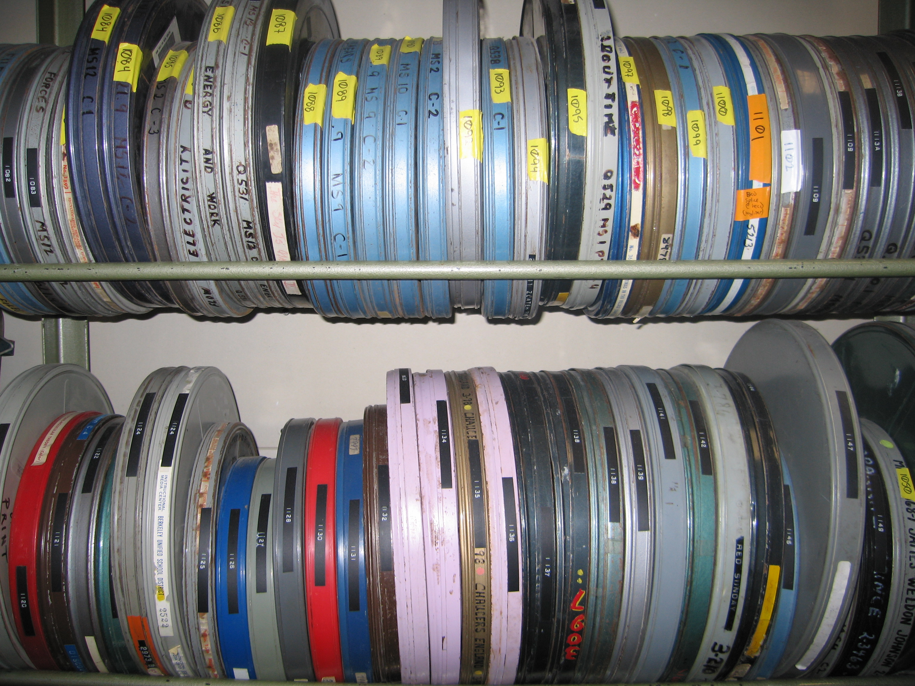
moving images
Notes:
FILM AND MOVING IMAGES
Another area where CC is emerging is the film industry.
Photo: 16mm educational film screening by lorelei, http://www.flickr.com/photos/filmfatale/423329167. Available under a Creative Commons Attribution 2.0 Generic licence. Full terms available at http://creativecommons.org/licenses/by/2.0

Slide 21
Notes:
FILM – REVVER
- video sharing website
- films are ‘Revverised’
Revver is a video sharing website of the same ilk as popular video platform YouTube. But unlike YouTube, Revver operates on a revenue share model with content creators and users.
Website: Revver by Revver Inc. Unless otherwise noted, © copyright Revver Inc. All video content on the site is available under a Creative Commons Attribution-Noncommercial-No Derivative Works 2.5 Generic licence. Full terms available at http://creativecommons.org/licenses/by-nc-nd/2.5

Slide 22
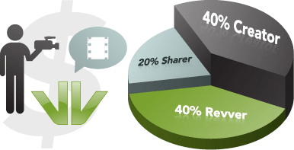
Notes:
FILM – REVVER
- 40% to Revver, 40% to Creator, 20% to Sharers
Revenue generated on each video is split between the Revver, the Creator and users who share the content with others. The revenue is raised from advertising that accompanies the video. When a content creator uploads a video to www.revver.com customised software inserts advertising into the film.
Video: Space Pizza by sethhendrix, http://revver.com/video/1165056/space-pizza. Available under a Creative Commons Attribution-Noncommercial-No Derivative Works 2.5 Generic licence. Full terms available at http://creativecommons.org/licenses/by-nc-nd/2.5

Slide 23
Notes:
FILM – REVVER
- graphic pop-up ads
These can be graphic ads
Video: Space Pizza by sethhendrix, http://revver.com/video/1165056/space-pizza. Available under a Creative Commons Attribution-Noncommercial-No Derivative Works 2.5 Generic licence. Full terms available at http://creativecommons.org/licenses/by-nc-nd/2.5

Slide 24
Notes:
FILM – REVVER
- Google pop-up ads
or Google ads that pop-up in a semi-transparent frame on top of the video
Video: Day the Invaders Came by scottmar818, http://revver.com/video/1076041/day-the-invaders-came. Available under a Creative Commons Attribution-Noncommercial-No Derivative Works 2.5 Generic licence. Full terms available at http://creativecommons.org/licenses/by-nc-nd/2.5

Slide 25
Notes:
FILM – REVVER
- Google ads at the end
or Google ads that appear at the end of a video. Each time an advert is clicked through the advertiser is charged.
Video: Extreme Diet Coke and Mentos Experiments by EepyBird, http://revver.com/video/27335/extreme-diet-coke-mentos-experiments. Available under a Creative Commons Attribution-Noncommercial-No Derivative Works 2.5 Generic licence. Full terms available at http://creativecommons.org/licenses/by-nc-nd/2.5

Slide 26
Notes:
FILM – REVVER
- usual web 2.0 functionality
But it isn’t just the revenue share model that sets Revver apart from similar services. Not only does Revver include the usual web 2.0 user features such as
Video: Extreme Diet Coke and Mentos Experiments by EepyBird, http://revver.com/video/27335/extreme-diet-coke-mentos-experiments. Available under a Creative Commons Attribution-Noncommercial-No Derivative Works 2.5 Generic licence. Full terms available at http://creativecommons.org/licenses/by-nc-nd/2.5

Slide 27
Notes:
FILM – REVVER
- subscribe to a user
subscribing to a user,
Video: Extreme Diet Coke and Mentos Experiments by EepyBird, http://revver.com/video/27335/extreme-diet-coke-mentos-experiments. Available under a Creative Commons Attribution-Noncommercial-No Derivative Works 2.5 Generic licence. Full terms available at http://creativecommons.org/licenses/by-nc-nd/2.5

Slide 28
Notes:
FILM – REVVER
- favourite videos
adding it to a users’ favourite items
Video: Extreme Diet Coke and Mentos Experiments by EepyBird, http://revver.com/video/27335/extreme-diet-coke-mentos-experiments. Available under a Creative Commons Attribution-Noncommercial-No Derivative Works 2.5 Generic licence. Full terms available at http://creativecommons.org/licenses/by-nc-nd/2.5

Slide 29
Notes:
FILM – REVVER
- add to social networks and bookmarking services
or their social networking and online bookmarking services,
Video: Extreme Diet Coke and Mentos Experiments by EepyBird, http://revver.com/video/27335/extreme-diet-coke-mentos-experiments. Available under a Creative Commons Attribution-Noncommercial-No Derivative Works 2.5 Generic licence. Full terms available at http://creativecommons.org/licenses/by-nc-nd/2.5

Slide 30
Notes:
FILM – REVVER
- videos not restricted to the platform
- can be downloaded
but it also allows users to download the video. Importantly, the downloaded version of the video also includes
Video: Extreme Diet Coke and Mentos Experiments by EepyBird, http://revver.com/video/27335/extreme-diet-coke-mentos-experiments. Available under a Creative Commons Attribution-Noncommercial-No Derivative Works 2.5 Generic licence. Full terms available at http://creativecommons.org/licenses/by-nc-nd/2.5

Slide 31
Notes:
FILM – REVVER
- downloaded videos have ads
an embedded, click through ad at the end of the video. Again, each time an advert is clicked through the advertiser is charged meaning that the video is able to be distributed by any means off-site such as email or peer-to-peer networks, as as long as there is an active internet connection the appropriate fee will be charged to the advertiser.
To encourage the dissemination of these videos, all videos on Revver are licensed under a Creative Commons Attribution-Noncommercial-No Derivative Works 2.5 Generic licence. The choice of licence is deliberate: Revver doesn’t want anyone else making money out of the work, and if the licence permitted remixing then users could simply remove the advertising which would undermine the business model. Of course, they want the filmmaker to be attributed, to incentivise the service and the value to them as a creator, but also to drive link backs to Revver.
Whether new business models like this are long-term sustainable is still uncertain. But in their first year of operation Revver
Video: Extreme Diet Coke and Mentos Experiments by EepyBird, http://revver.com/video/27335/extreme-diet-coke-mentos-experiments. Available under a Creative Commons Attribution-Noncommercial-No Derivative Works 2.5 Generic licence. Full terms available at http://creativecommons.org/licenses/by-nc-nd/2.5

Slide 32
Notes:
FILM – REVVER
- all videos on Revver are CC BY-NC-ND 2.5 Generic licence
an embedded, click through ad at the end of the video. Again, each time an advert is clicked through the advertiser is charged meaning that the video is able to be distributed by any means off-site such as email or peer-to-peer networks, as as long as there is an active internet connection the appropriate fee will be charged to the advertiser.
To encourage the dissemination of these videos, all videos on Revver are licensed under a Creative Commons Attribution-Noncommercial-No Derivative Works 2.5 Generic licence. The choice of licence is deliberate: Revver doesn’t want anyone else making money out of the work, and if the licence permitted remixing then users could simply remove the advertising which would undermine the business model. Of course, they want the filmmaker to be attributed, to incentivise the service and the value to them as a creator, but also to drive link backs to Revver.
Whether new business models like this are long-term sustainable is still uncertain. But in their first year of operation Revver
Video: Extreme Diet Coke and Mentos Experiments by EepyBird, http://revver.com/video/27335/extreme-diet-coke-mentos-experiments. Available under a Creative Commons Attribution-Noncommercial-No Derivative Works 2.5 Generic licence. Full terms available at http://creativecommons.org/licenses/by-nc-nd/2.5
Icons: The Pink CC logo is a derivative work of the CC logo by Creative Commons Corporation. The Pink Attribution icon, the Pink Noncommercial icon and the Pink No Derivative Works icon are derivative works of the Attribution element icon, the Noncommercial element icon and the No Derivative Works element icon by Creative Commons Corporation. The original logo and element icons are available under a Creative Commons Attribution 3.0 Unported licence. Full terms are available at http:// creativecommons.org/licenses/by/3.0. The original logo and element icons are available for reuse in accordance with the Creative Commons trademark policy available at http:// creativecommons.org/presskit. The Pink CC logo, the Pink Attribution icon, the Pink Noncommercial icon and the Pink No Derivative Works icon by Elliott Bledsoe are available under a Creative Commons Attribution 2.5 Australia licence. Full terms are available at http:// creativecommons.org/licenses/by/2.5/au

Slide 33
$1 million (USD)
Notes:
FILM – REVVER
- $1 million USD to users in first 12 months
paid out a $1 million US Dollars to creators and sharers on the platform. The most amount paid to any one user was
Source: Gonazlez, N, Revver: $1 Million In User Payouts In First 12 Months on Tech Crunch, 12 September 2007, http://www.techcrunch.com/2007/09/12/revver-1-million-in-user-payouts-12-months

Slide 34
$28000 (USD)
Notes:
FILM – REVVER – EEPYBIRD
- $28000 to a single user
$28000 paid to
Source: La Monica, P, Making money from Mentos on CNN Money, 14 July 2006, http://money.cnn.com/2006/07/13/news/funny/mentos_dietcoke/index.htm

Slide 35
Notes:
FILM – REVVER – EEPYBIRD
- EepyBird
these two guys: to Fritz Grobe and Stephen Voltz, under the joint username EepyBird. Grobe and Voltz created a the film Extreme Diet Coke and Mentos Experiments which featured elaborately choreographed fountains resulting from a chemical reaction when
Video: Extreme Diet Coke and Mentos Experiments by EepyBird, http://revver.com/video/27335/extreme-diet-coke-mentos-experiments. Available under a Creative Commons Attribution-Noncommercial-No Derivative Works 2.5 Generic licence. Full terms available at http://creativecommons.org/licenses/by-nc-nd/2.5

Slide 36
500+ Mentos
Notes:
FILM – REVVER – EEPYBIRD
- 500+ Mentos
over 500 Mentos candies on strings were dropped into

Slide 37
101 bottles
Notes:
FILM – REVVER – EEPYBIRD
- 101 bottles
- video posted 31 May 2006
101 bottles of Diet Coke with holes drilled in their lids. On 31 May 2006 the movie was uploaded to www.eepybird.com and Revver. Within a few hours the views

Slide 38
4000 views
Notes:
FILM – REVVER – EEPYBIRD
- 4000 views
topped 4000 unique views and was increasing by about

Slide 39
1000 views/hour
Notes:
FILM – REVVER – EEPYBIRD
- increased by 1000 views per hour
1000 views per hour.

Slide 40
5 million views
Notes:
FILM – REVVER – EEPYBIRD
- 5 million views within 2 months
Within 2 months the video had been viewed more than 5 millions times.

Slide 41
11 585 595 views
Notes:
FILM – REVVER – EEPYBIRD
- more than 11.5 million this morning
This morning the film’s view tally was more than 11 and a half million.
The next case study I want to tell you about concerns

Slide 42
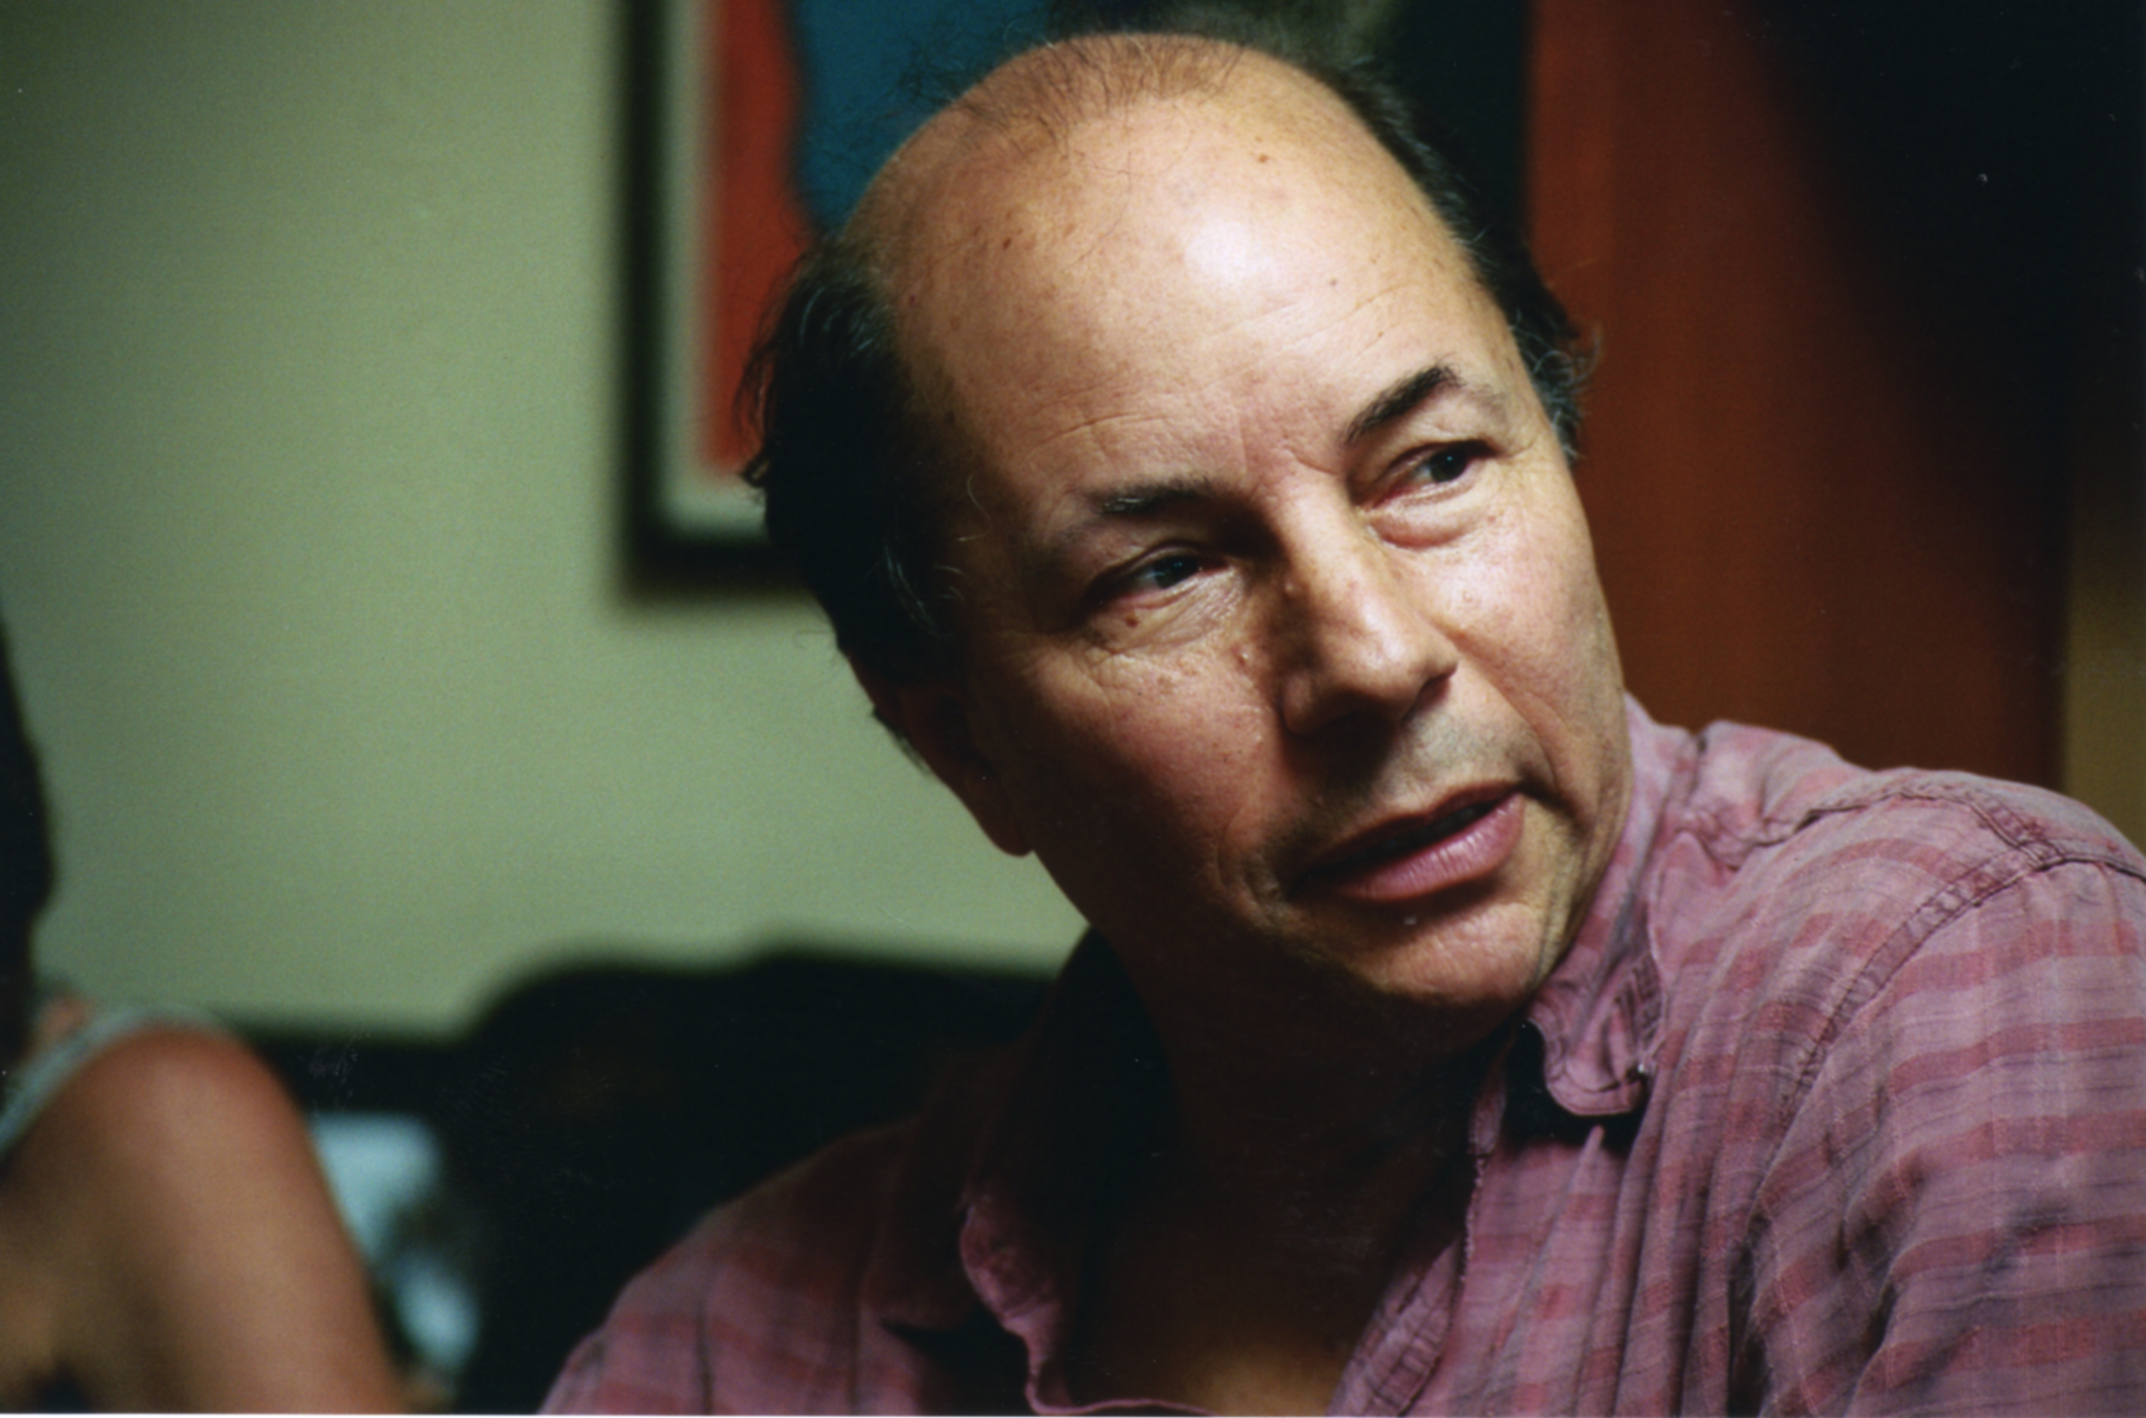
Notes:
FILM – ROBERT GREENWALD
- director, producer, documentarian Robert Greenwald
- directed Steal This Movie, Uncovered: The War on Iraq, Wal-Mart: The High Cost of Low Prices and most recently Iraq for Sale: The War Profiteers
this guy. He’s director, producer and documentarian Robert Greenwald, owner of Brave New Films. You may know some of his work; he directed Steal This Movie, Uncovered: The War on Iraq, Wal-Mart: The High Cost of Low Prices and most recently Iraq for Sale: The War Profiteers. But I want to talk about one of his other films.
Photo: RPPH0113.04 by Brave New Films, http://www.flickr.com/photos/walmartmovie/25346998. Available under a Creative Commons Attribution 2.0 Generic licence. Full terms available at http://creativecommons.org/licenses/by/2.0

Slide 43

Notes:
FILM – ROBERT GREENWALD
- Outfoxed: Rupert Murdoch’s War on Journalism
- expose alleged bias in reporting
- relies on Fox footage
- Greenwald sought permission for Fox footage
- other third parties were refusing to license content
Namely Outfoxed: Rupert Murdoch’s War on Journalism. The documentary is designed expose the ways that Fox News allegedly distorts its reporting to serve the conservative political leaning of its owner Rupert Murdoch. As such it utilises extensive footage from the news service to make its point, most of which Greenwald sought permission for. But funnily enough it was not Fox that posed the biggest threat to getting the message out. A number of other media organisations who owned rights to content Greenwald wanted to use were unexpectedly refusing to licence content that would ordinarily have been granted pro forma. CBS wouldn't sell Greenwald the clip of former White House counterterrorism coordinator and author of Against All Enemies: Inside America's War On Terror Richard Clarke's appearance on ‘60 Minutes, because it didn’t want to be associated with a controversial documentary about Murdoch. Similarly, WGBH, the Boston Public Broadcaster, wouldn't let Greenwald use excerpts from Frontline for fear of looking too political. Even if Greenwald had left the most contentious and litigious content in the film and relied on the strength of a fair use claim, as he said, “as a practical matter the high costs of litigation force most filmmakers to simply remove the material in question.”
It is precisely this first hand experience of the permissions culture that was the impetus for Greenwald’s decision
Source: Boynton, R S, “How to Make a Guerrilla Documentary” in The New York Times, 11 July 2004, http://www.nytimes.com/2004/07/11/magazine/11FOX.html?ei=5090&en=9d0fa030408198b9&ex=1247284800&partner=rssuserland&pagewanted=all&position

Slide 44

Notes:
FILM – ROBERT GREENWALD
- original footage from Outfoxed and Uncovered released under a CC Sampling + licence
to release the original footage he created when filming Outfoxed and Uncovered, plus a back catalogue of interview footage not in the films, under a Creative Commons Sampling Plus licence, which allows people to take and transform pieces of the work for any purpose other than advertising and allows for non-commercial copying and distribution. “I could think of no better way to walk the talk myself than by releasing the interviews from Outfoxed and Uncovered under a [Creative Commons] licence that allows other filmmakers to reuse my material in new and creative ways,” Greenwald explains, “I look forward to seeing what others do with these interviews.
Icons: The Pink CC logo is a derivative work of the CC logo by Creative Commons Corporation. The Pink Sampling Plus icon is a derivative work of the Sampling Plus element icon by Creative Commons corporation. The original logo and element icon are available under a Creative Commons Attribution 3.0 Unported licence. Full terms are available at http:// creativecommons.org/licenses/by/3.0. The original logo and element icons are available for reuse in accordance with the Creative Commons trademark policy available at http:// creativecommons.org/presskit. The Pink CC logo and the Pink Sampling Plus icon by Elliott Bledsoe are available under a Creative Commons Attribution 2.5 Australia licence. Full terms are available at http:// creativecommons.org/licenses/by/2.5/au

Slide 45
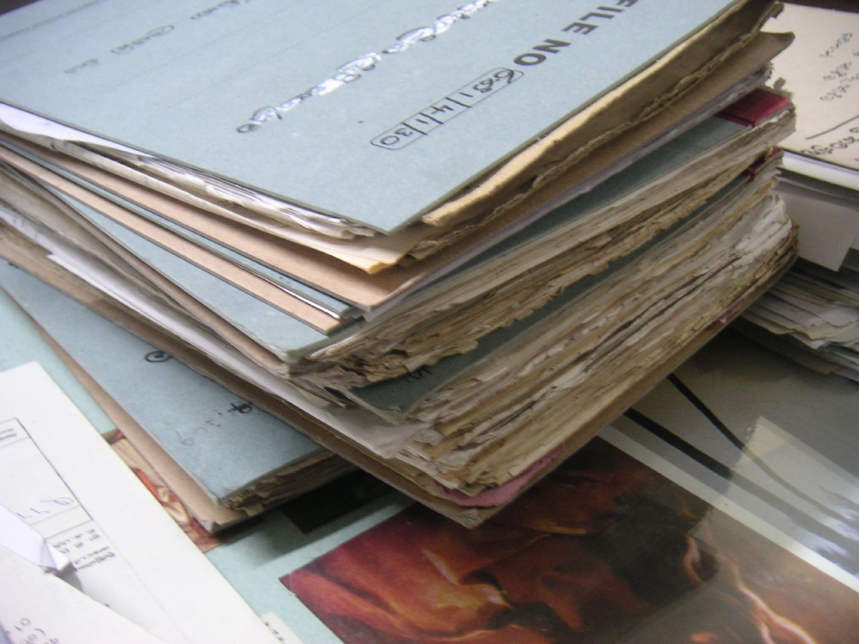
institutions
Notes:
GOVERNMENT INSTITUTIONS, GALLERIES AND LIBRARIES
Libraries, galleries and other government institutions also know the cost and effort associated with clearing copyright.
Photo: Lanka Government Office Files by arquera, http://www.flickr.com/photos/puntodevista/114155928. Available under a Creative Commons Attribution 2.0 Generic licence. Full terms available at http://creativecommons.org/licenses/by/2.0

Slide 46
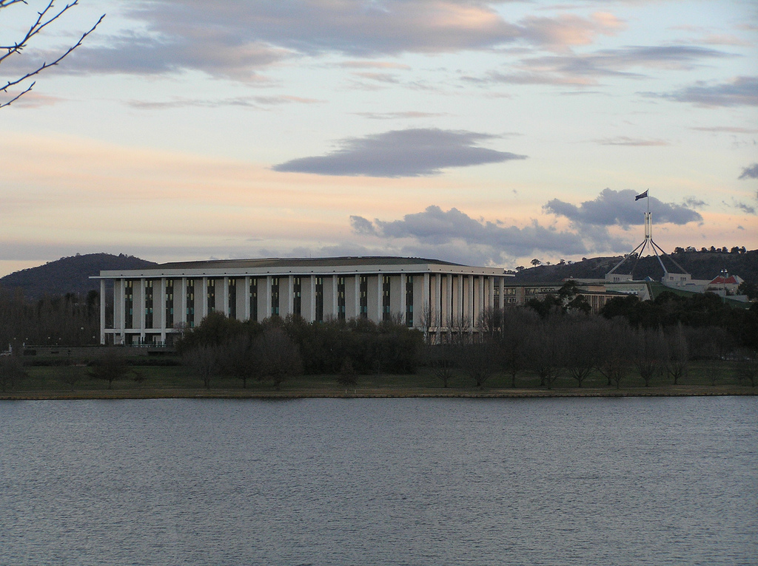
Notes:
INSTITUTIONS – NATIONAL LIBRARY OF AUSTRALIA
- largest reference library in australia
This the National Library of Australia; Australia’s largest reference library, charged under the National Library Act 1960 with "maintaining and developing a national collection of library material, including a comprehensive collection of library material relating to Australia and the Australian people.” The library is home to a number of collections including the extensive
Photo: National Library of Australia, Canberra, ACT by Brendan Ashton, http://www.flickr.com/photos/29901446@N07/2800992825. Available under a Creative Commons Attribution 2.0 Generic licence. Full terms available at http://creativecommons.org/licenses/by/2.0

Slide 47

Notes:
INSTITUTIONS – NLA – PICTURE AUSTRALIA
Picture Australia portal which was launched in 2000.

Slide 48
Notes:
INSTITUTIONS – NLA – PICTURE AUSTRALIA
- pictorial search gateway
- search multiple institutional collections
- concern at lack of contemporary photography
Using the Picture Australia gateway you can search the National Library’s pictorial collections as well as the collections of all the State Libraries, a number of State Archives, numerous City Council and university libraries, the National Archives of Australia, the Australian War Memorial, the CSIRO, the National Library of New Zealand and a number of other institutions.
The NLA conducted a survey on the Picture Australia archive and discovered that people wanted more contemporary images to be available on the Picture Australia service. Of course, the time, effort and costs associated with clearing the rights to contemporary photos for inclusion in the national collection were a major consideration when embarking on a project of update the content. Creative Commons was recognised as a mean by which the NLA could ensuring that the library has the rights it needs to harvest, maintain and promote the collection, while still allowing the individual to retain control over how their image is made available. As Ms Hooton puts it, Creative Commons licensing “encourages content contributors to think in terms of a librarian keeping in mind the public benefit of providing maximum access to content as part of Australia’s national collection.”
Equally, Flickr was suggested as an easy way to let the public upload and provide metadata for their images, which the library could then harvest. In January 2006 the NLA embarked on a collaboration with Yahoo’s photo publishing website Flickr to facilitate the collection of public contributions to the Picture Australia archive. They established two Flickr groups:
Website: Picture Australia by National Library of Australia, http://www.pictureaustralia.org
Source: National Library of Australia ‘Click and Flick’ on Creative Commons, http://wiki.creativecommons.org/National_Library_of_Australia_%27Click_and_Flick%27. Available under a Creative Commons Attribution 3.0 Unported licence. Full terms are available at http:// creativecommons.org/licenses/by/3.0.

Slide 49
Notes:
INSTITUTIONS – NLA – PICTURE AUSTRALIA – CLICK AND FLICK
- collaboration with Flickr
‘Picture Australia: People, places and events’ Flickr Group, a place where people can post images social, political, contemporary or historical events of national significance. The group ‘Picture Australia: Australia Day’ was also established but was closed down because it could be encompassed in the former group.
The NLA encourages the use of CC because of how simple it makes it rights clearance processes. The explanation on the Flickr groups says:
“Picture Australia selects Creative Common licensed images when producing audio visual displays for National events and festivals e.g.: National Folk Festival or the upcoming 2008 National Photography Festival. Because of the amount of work involved in rights clearing, it is not feasible to use "all rights reserved" images for audio visual display purposes.“
Photographs added to these groups,
Website: Picture Australia: People, places and events on Flickr, http://www.flickr.com/groups/PictureAustralia_ppe

Slide 50
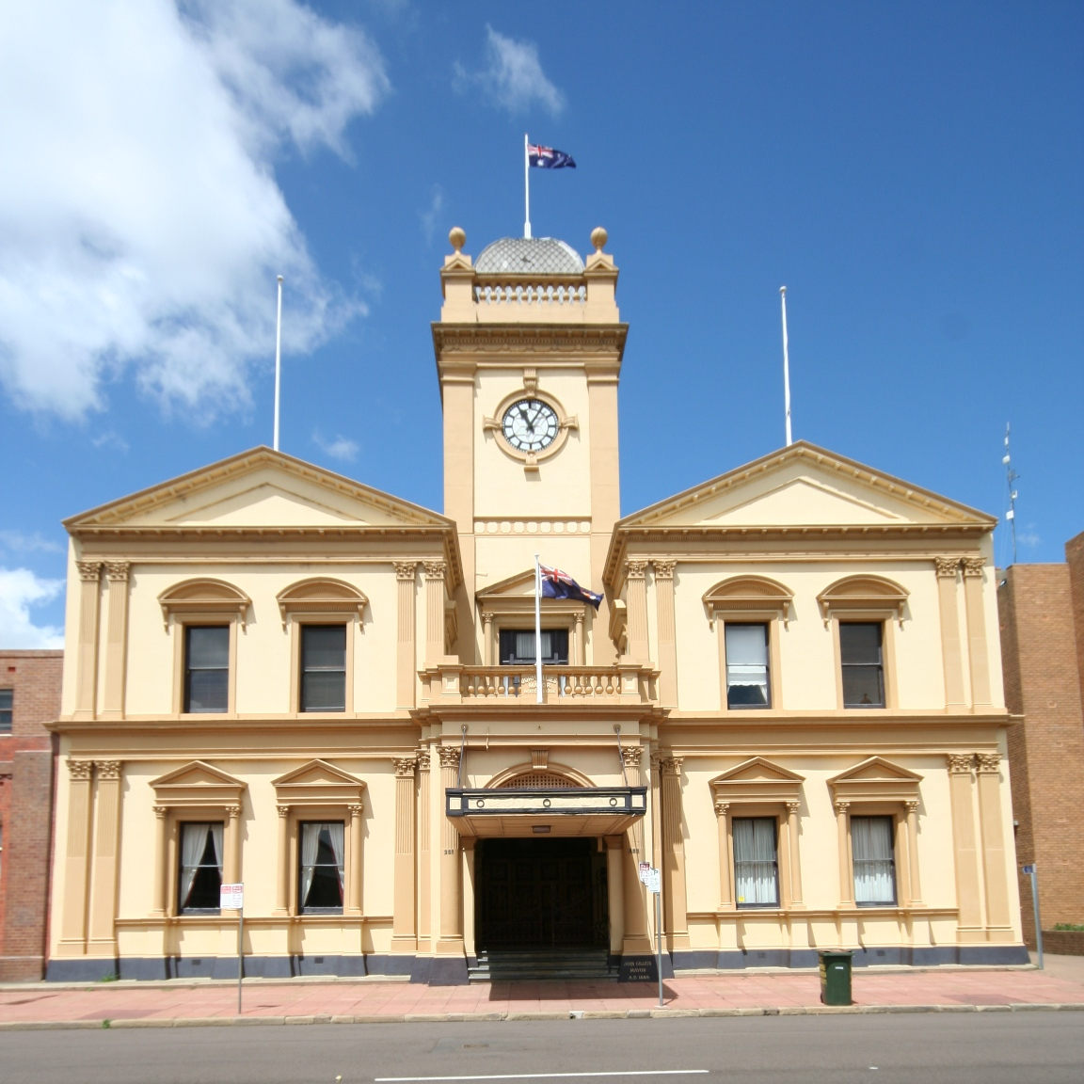
Notes:
INSTITUTIONS – NLA – PICTURE AUSTRALIA – CLICK AND FLICK
- collaboration with Flickr
such as this photo of Maitland Town Hall in New South Wales,
Photo: Town Hall IMG_8105 by OZinOH, http://www.flickr.com/photos/75905404@N00/2159878596. Available under a Creative Commons Attribution 2.0 Generic licence. Full terms available at http://creativecommons.org/licenses/by/2.0

Slide 51
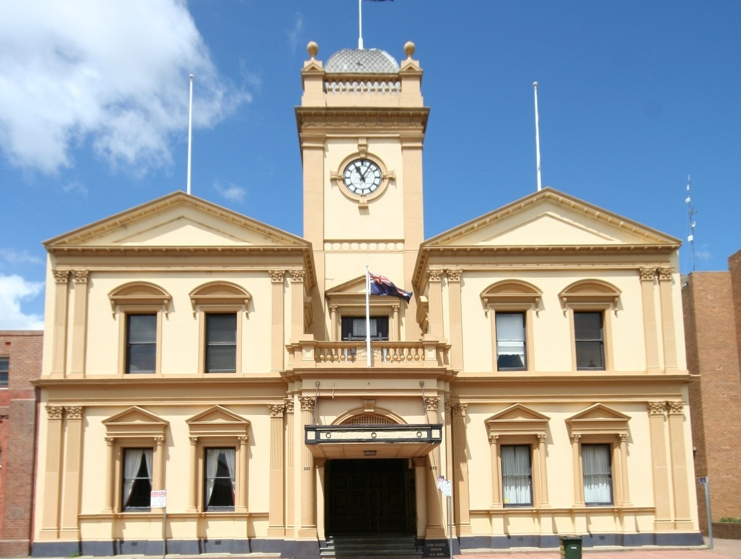
Notes:
INSTITUTIONS – NLA – PICTURE AUSTRALIA
- pictorial search gateway
- search multiple institutional collections
- concern at lack of contemporary photography
are automatically be indexed by the Picture Australia archive unless the user specifies otherwise.
The NLA encouraged CC licensing.
Website: Picture Australia by National Library of Australia, http://www.pictureaustralia.org
Source: National Library of Australia ‘Click and Flick’ on Creative Commons, http://wiki.creativecommons.org/National_Library_of_Australia_%27Click_and_Flick%27. Available under a Creative Commons Attribution 3.0 Unported licence. Full terms are available at http:// creativecommons.org/licenses/by/3.0.

Slide 52
Notes:
INSTITUTIONS – NLA – PICTURE AUSTRALIA
- pictorial search gateway
- search multiple institutional collections
- concern at lack of contemporary photography
By using Flickr, which makes the inclusion of metadata such as titles, locations and tag keywords really easy for users to do, the Picture Australia archive can easily read and generate this same information.
The NLA encouraged CC licensing.
Website: Picture Australia by National Library of Australia, http://www.pictureaustralia.org
Source: National Library of Australia ‘Click and Flick’ on Creative Commons, http://wiki.creativecommons.org/National_Library_of_Australia_%27Click_and_Flick%27. Available under a Creative Commons Attribution 3.0 Unported licence. Full terms are available at http:// creativecommons.org/licenses/by/3.0.

Slide 53
35 858 photos
Notes:
INSTITUTIONS – NLA – PICTURE AUSTRALIA
- 35 000+ photos in the ‘People, places and events’ group
As of this morning when I checked, the ‘People, places and events’ group included more than 35 000 photographs.

Slide 54
Notes:
INSTITUTIONS – NLA – PICTURE AUSTRALIA – CLICK AND FLICK
- launched Ourtown group in January 2007
After successfully launching the ‘People, places and events’ group, the NLA launched its third Flickr group in January 2007. ‘Picture Australia: Ourtown’ was designed to attract contributions to the archive that depicted past and present reflections of Australia and its people. Unlike ‘People, places and events’ and ‘Australia Day’ the NLA made it compulsory that contributions to the archive be under a Creative Commons licence. However, in August 2007 the NLA reversed this decision at the prompting of several members of the photography community. Optional licensing ensures that photographers can retain maximum control over their work should they choose.
Website: Picture Australia: Ourtown on Flickr, http://www.flickr.com/groups/pa_ourtown

Slide 55
2854 photos
Notes:
INSTITUTIONS – NLA – PICTURE AUSTRALIA
- 2800+ photos in the ‘Ourtown’ group
Again, as of this morning ‘Ourtown’ currently includes 2854 photos.

Slide 56
Notes:
INSTITUTIONS – NLA – PICTURE AUSTRALIA – RE-PICTURE AUSTRALIA
- launched ‘Re-Picture Australia’ group in December 2007
- makes available public domain images for remixing
More recently the NLA has launched a new Flickr group, ‘Re-Picture Australia’ which makes available a number of public domain images from the Picture Australian participant institutions and collections for users to creatively reuse, reinterpret and ‘re-picture’ Australia’s national collections.
Website: Re-Picture Australia by National Library of Australia, http://www.pictureaustralia.org/contest/index.html

Slide 57
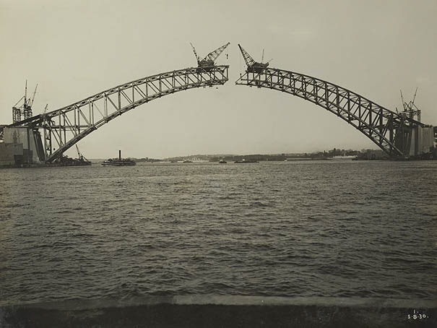
Notes:
INSTITUTIONS – NLA – PICTURE AUSTRALIA – RE-PICTURE AUSTRALIA
- launched ‘Re-Picture Australia’ group in December 2007
The group encourages people to take hi resolution images from the institutional collections and
Photo: View from McMahons Point by unknown photographer, held by the State Records of New South Wales, http://investigator.records.nsw.gov.au/asp/photosearch/photo.asp?12685_a007_a00704_8730000010r. This image is in the Public Domain.

Slide 58

Notes:
INSTITUTIONS – NLA – PICTURE AUSTRALIA – RE-PICTURE AUSTRALIA
sample and
Photo: Bridge Redux Part II by zebrafactory.com, http://www.flickr.com/photos/45144498@N00/2510877137, is a derivative of View from McMahons Point by unknown photographer, held by the State Records of New South Wales, http://investigator.records.nsw.gov.au/asp/photosearch/photo.asp?12685_a007_a00704_8730000010r. © copyright Christopher Young. The original image is in the Public Domain.

Slide 59
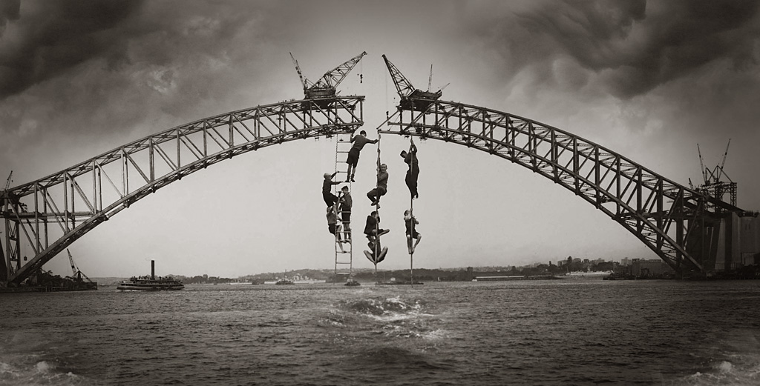
Notes:
INSTITUTIONS – NLA – PICTURE AUSTRALIA – RE-PICTURE AUSTRALIA
remix them into new works.
Photo: Bridge Redux Part II by zebrafactory.com, http://www.flickr.com/photos/45144498@N00/2510877137, is a derivative of View from McMahons Point by unknown photographer, held by the State Records of New South Wales, http://investigator.records.nsw.gov.au/asp/photosearch/photo.asp?12685_a007_a00704_8730000010r. © copyright Christopher Young. The original image is in the Public Domain.

Slide 60
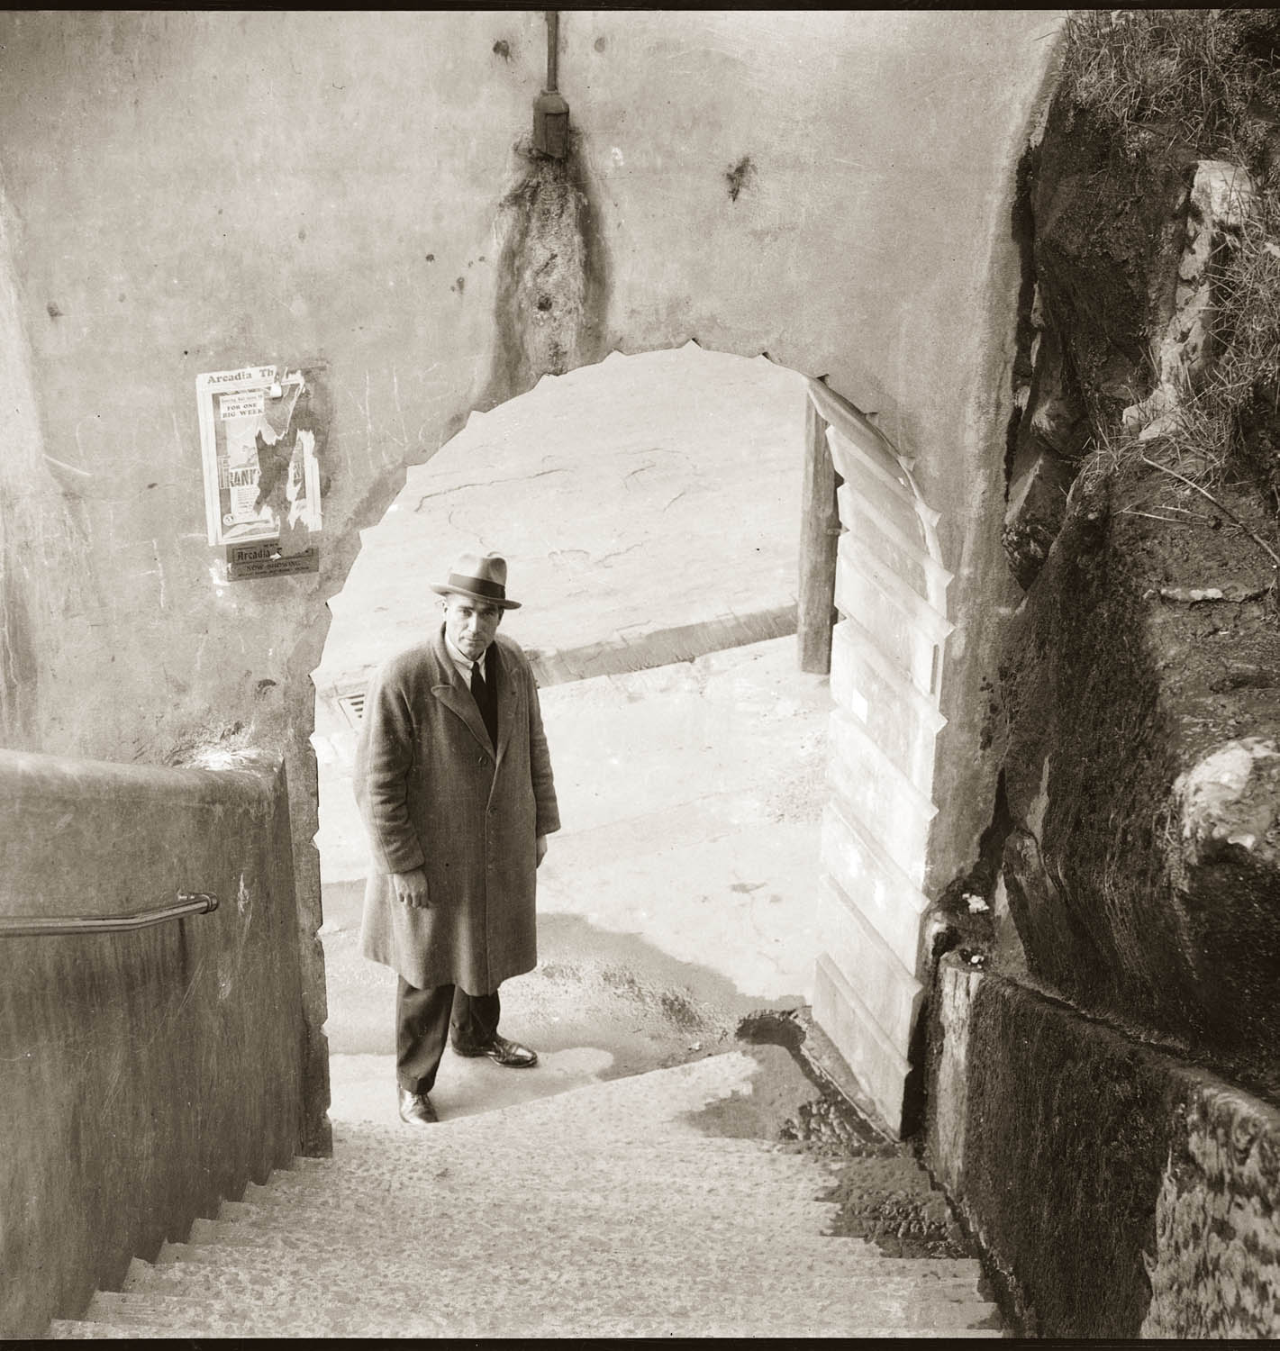
Notes:
INSTITUTIONS – NLA – PICTURE AUSTRALIA – RE-PICTURE AUSTRALIA
By reworking Public Domain images
Photo: Detective at foot of Argyle Steps, The Rocks (Sydney), late 1930s by New South Wales Police Department, held by the Historic Houses Trust, Department of Sports and Recreation, New South Wales Government, http://collection.hht.net.au/firsthhtpictures/picturerecord.jsp?recno=31215. This image is in the Public Domain.

Slide 61
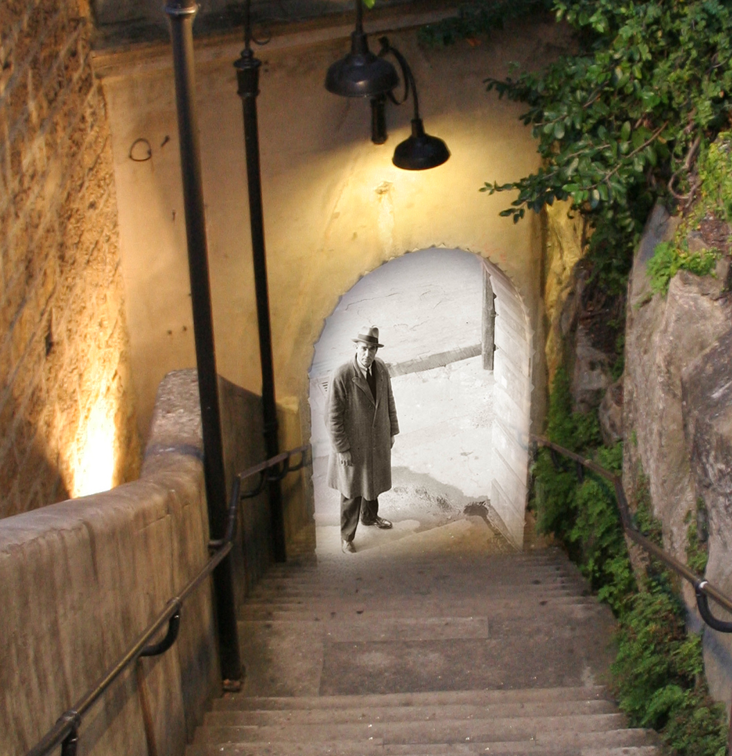
Notes:
INSTITUTIONS – NLA – PICTURE AUSTRALIA – RE-PICTURE AUSTRALIA
into new creative works
Photo: The Argyle Stairs 1930 to 2008 by Rossco ( R & V Photographers ), http://flickr.com/photos/rustie/2510318574, is a derivative work of Detective at foot of Argyle Steps, The Rocks (Sydney), late 1930s by New South Wales Police Department, held by the Historic Houses Trust, Department of Sports and Recreation, New South Wales Government, http://collection.hht.net.au/firsthhtpictures/picturerecord.jsp?recno=31215. Available under a Creative Commons Attribution 2.0 Generic licence. Full terms available at http://creativecommons.org/licenses/by/2.0. The original image is in the Public Domain.

Slide 62

Notes:
INSTITUTIONS – NLA – PICTURE AUSTRALIA – RE-PICTURE AUSTRALIA
the NLA hopes to ‘[bring] fresh significance
Photo: Good Men Are Protected by Rossco ( R & V Photographers ), http://flickr.com/photos/rustie/2329509101, is a derivative work of Detective at foot of Argyle Steps, The Rocks (Sydney), late 1930s by New South Wales Police Department, held by the Historic Houses Trust, Department of Sports and Recreation, New South Wales Government, http://collection.hht.net.au/firsthhtpictures/picturerecord.jsp?recno=31215. Available under a Creative Commons Attribution 2.0 Generic licence. Full terms available at http://creativecommons.org/licenses/by/2.0. The original image is in the Public Domain.

Slide 63
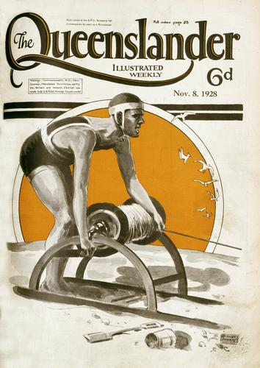
Notes:
INSTITUTIONS – NLA – PICTURE AUSTRALIA – RE-PICTURE AUSTRALIA
to the historical collection material
Photo: Illustrated front cover from The Queenslander, 8 November 1928 by Garnet Agnew, held by the John Oxley Library, State Library of Queensland, http://enc.slq.qld.gov.au/logicrouter/servlet/LogicRouter?PAGE=object&OUTPUTXSL=object_enc36ui.xslt&pm_RC=PICTQLD&pm_OI=16710&api_1=GET_OBJECT_XML&num_result=0. This image is in the Public Domain.

Slide 64
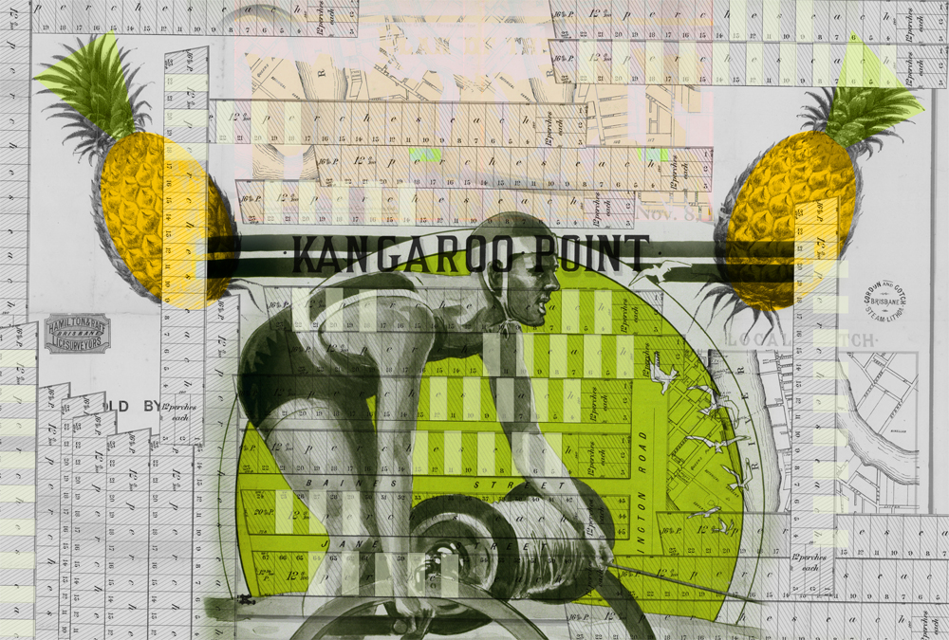
Notes:
INSTITUTIONS – NLA – PICTURE AUSTRALIA – RE-PICTURE AUSTRALIA
available in Picture Australia.
Photo: Kangaroo Point by shealo, http://flickr.com/photos/shealo/2301345287, is a derivative work of Illustrated front cover from The Queenslander, 8 November 1928 by Garnet Agnew, held by the John Oxley Library, State Library of Queensland, http://enc.slq.qld.gov.au/logicrouter/servlet/LogicRouter?PAGE=object&OUTPUTXSL=object_enc36ui.xslt&pm_RC=PICTQLD&pm_OI=16710&api_1=GET_OBJECT_XML&num_result=0. Available under a Creative Commons Attribution-Noncommercial-Share Alike 2.0 Generic licence. Full terms available at http://creativecommons.org/licenses/by-nc-sa/2.0. The original image is in the Public Domain.

Slide 65

music
Notes:
MUSIC, SOUND & AUDIO
On to music.
Photo: Music is my religion by [nati], http://www.flickr.com/photos/natita2/2565850315. Available under a Creative Commons Attribution 2.0 Generic licence. Full terms available at http://creativecommons.org/licenses/by/2.0

Slide 66
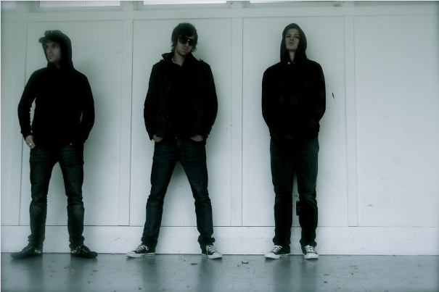
Notes:
MUSIC – KNIVES AT NOON
- indie-electric-rock band
If these guys look like an indie-electric-rock band, that’s because they are.
Photo: © copyright Teri Lyn Higgins. Used with permission.

Slide 67

Notes:
MUSIC – KNIVES AT NOON
- indie-electric-rock band
They’re Knives at Noon. Formed in late 2007, they’ve have already racked up some notable successes including being placed in the top 32 bands for MTV’s Kickstart Competition and completing a national tour, finishing up with a session at the Red Bull Live to Air Studio in May.

Slide 68

Notes:
MUSIC – KNIVES AT NOON
- released self-titled debut EP
The boys from the band attribute their success to their reliance on modern technology and music sharing practices including Creative Commons, enabling them to create their unique sound as well as to build their fan base. They explain that, at one point, the band members were spread between Dunedin, Auckland and Papua New Guinea, which led to working via the Internet and post to construct tracks. What resulted was their self-titled, 6 track, debut EP.
But being a live band they were never entirely happy with how final and ‘in stone’ the EP sounded. They were interested in the idea of letting people remix the tracks, but were uncertain how to progress. After being exposed to Creative Commons, base and synth player recommended releasing the tracks under a CC licence that permitted remixing to the other band members.
Album artwork: Cover art of Knives at Noon EP by Knives at Noon, http://www.myspace.com/knivesatnoon. Available under a Creative Commons Attribution-Noncommercial-Share Alike 3.0 New Zealand licence. Full terms available at http://creativecommons.org/licenses/by-nc-sa/3.0/nz

Slide 69

Notes:
MUSIC – KNIVES AT NOON
- released self-titled debut EP
So they released the tracks under a Creative Commons Attribution-Noncommercial-Share Alike 3.0 New Zealand licence to facilitate working relationships with other musicians who want to remix the current EP songs. Already, artists such as Future One (Auckland), Darkist (UK), Dean Lawz (Australia), Woosh (Dunedin), MC Beau (Dunedin), Undertow (Dunedin), Module (Wellington) and Michael Schraa (Dunedin) are remixing tracks.
Album artwork: Cover art of Knives at Noon EP by Knives at Noon, http://www.myspace.com/knivesatnoon. Available under a Creative Commons Attribution-Noncommercial-Share Alike 3.0 New Zealand licence. Full terms available at http://creativecommons.org/licenses/by-nc-sa/3.0/nz
Icons: The Pink CC logo is a derivative work of the CC logo by Creative Commons Corporation. The Pink Attribution icon, the Pink Noncommercial icon and the Pink Share Alike icon are derivative works of the Attribution element icon, the Noncommercial element icon and the Share Alike element icon by Creative Commons Corporation. The original logo and element icons are available under a Creative Commons Attribution 3.0 Unported licence. Full terms are available at http:// creativecommons.org/licenses/by/3.0. The original logo and element icons are available for reuse in accordance with the Creative Commons trademark policy available at http:// creativecommons.org/presskit. The Pink CC logo, the Pink Attribution icon, the Pink Noncommercial icon and the Pink Share Alike icon by Elliott Bledsoe are available under a Creative Commons Attribution 2.5 Australia licence. Full terms are available at http:// creativecommons.org/licenses/by/2.5/au

Slide 70

Notes:
MUSIC – KNIVES AT NOON
- Benny electric remix
In Australia, Brisbane DJ Benny Electric’s remix of the track Get Outta My Head won the Voter’s Choice for June 2008 on the social network MySongCast. He also has remixed Knive at Noon’s track Heat Up. Recently began negotiations with a dance label in the UK.
Knives at Noon are by no means the only musician who wants to see others remix their work.
Album artwork: Cover art of Get Outta My Head – Benny Electric vs Knives at Noon by Benny Electric, http://www.myspace.com/bennyelectric. Available under a Creative Commons Attribution-Noncommercial-Share Alike 3.0 New Zealand licence. Full terms available at http://creativecommons.org/licenses/by-nc-sa/3.0/nz
Icons: The Pink CC logo is a derivative work of the CC logo by Creative Commons Corporation. The Pink Attribution icon, the Pink Noncommercial icon and the Pink Share Alike icon are derivative works of the Attribution element icon, the Noncommercial element icon and the Share Alike element icon by Creative Commons Corporation. The original logo and element icons are available under a Creative Commons Attribution 3.0 Unported licence. Full terms are available at http:// creativecommons.org/licenses/by/3.0. The original logo and element icons are available for reuse in accordance with the Creative Commons trademark policy available at http:// creativecommons.org/presskit. The Pink CC logo, the Pink Attribution icon, the Pink Noncommercial icon and the Pink Share Alike icon by Elliott Bledsoe are available under a Creative Commons Attribution 2.5 Australia licence. Full terms are available at http:// creativecommons.org/licenses/by/2.5/au

Slide 71
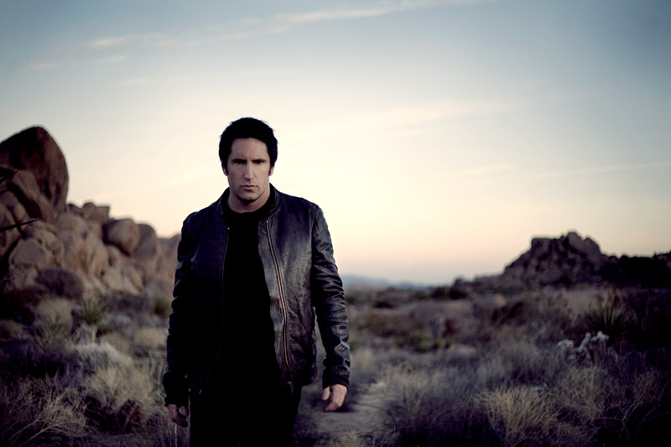
Notes:
TRENT REZNOR, NINE INCH NAILS
- American musician
- Front man only permanent member and creative force behind Nine Inch Nails
So does this guy. It’s Trent Reznor, front man, only permanent member and creative force behind American Industrial rock act
Photo: Taken by Rob Sheridan. Available as Trent Reznor, February, 2008 (Press Photo) by Nine Inch Nails Official, http://www.flickr.com/photos/nineinchnails/2348368204. Available under a Creative Commons Attribution-Share Alike 2.0 Generic licence. Full terms available at http://creativecommons.org/licenses/by-sa/2.0

Slide 72

Notes:
NINE INCH NAILS
- Won 2 Grammy Awards, nominated for 10
Nine Inch Nails. He has been hailed as one of the most acclaimed creative figures of his generation of music[1]. Over his career Trent Reznor has appeared in the Time magazine list of most influential people (1997)[2] and Spin magazine’s list of most vital artists in music (1997) [3]. The band has been nominated 10 times for Grammy awards, presented by the National Academy of Recording Arts and Sciences in the United States of America.
[1] Boucher, G. “Trent Reznor: Back from the abyss” in Los Angeles Times, 31 August 2008, http://www.latimes.com/entertainment/news/music/la-ca-nin31-2008aug31,0,7102117.story
[2] “Time’s 25 Most Influential Americans” in Time, 21 April 2007, http://www.time.com/time/magazine/article/0,9171,986206-17,00.html
[3] “The Spin Top 40: The Most Vital Artists in Music, 1997” in Spin, 4 January 1997.

Slide 73
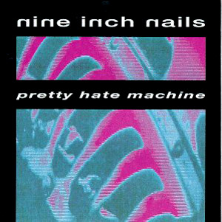

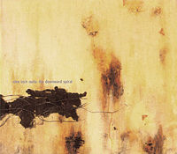
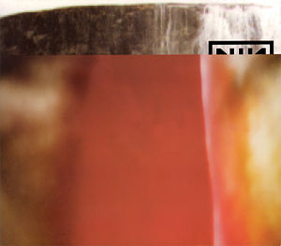

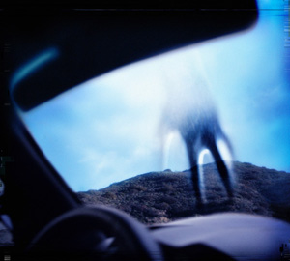
Notes:
NINE INCH NAILS
- Release 6 albums
- 5 albums under Universal Music Group’s subsidiary Interscope Records
In April last year the band released their sixth studio album, Year Zero. Their first, Pretty Hate Machine released on now-defunct label TVT Records, was the only album not released on Reznor’s label Nothing Records. Nothing was a subsidiary of Interscope Records, which was a subsidiary of Interscope. Interscope’s parent company is the Universal Music Group.
Album artwork: Cover art of Pretty Hate Machine, Broken, The Downward Spiral, The Fragile, With Teeth and Year Zero (from top, left to bottom right) by Nine Inch Nails. © copyrightNine Inch Nails. ℗ copyright in sound recording in order of album: Pretty Hate Machine, 2007 Interscope Records; Broken, 1992 TVT/Interscope Records; The Downward Spiral, 1994 TVT/Interscope Records; The Fragile, 1999 Interscope Records; With Teeth, 2005 Interscope Records and Year Zero, 2007 Interscope Records.

Slide 74
20 million records
Notes:
NINE INCH NAILS
- sold 20 million plus records
- vowed to leave Interscope
- Ghosts I-IV released on 2 March 2008
During this period, the band sold more than 20 million records.
But increasingly Trent Reznor grew dissatisfied with the record industry. I am sure we all remember when he played the Metro in Sydney in 2005 while out here on their Australian Tour. He famously let fly at the music industry and in particular his record label, encouraging people to steal his music. But that is not to say that Reznor doesn’t want to get paid for making music. In an interview with the Hearald Sun he explained that “…it's tough not to resent people for [downloading] when you're the guy making the music, that would like to reap a benefit from that” but on the other hand the record label is ripping those same people off. He recounted walking in a HMV store in Sydney and discovering that his CDs and DVDs sold for between $6 and $10 more than other recent releases. When he asked his label about it they said “…it's because we know you've got a core audience that's gonna buy whatever we put out, so we can charge more for that. It's the pop stuff we have to discount to get people to buy it. True fans will pay whatever". And as far as the extra $10 goes? Reznor’s response was, “That money's not going into my pocket.”
It is at this point Reznor declared he was leaving Universal. He said I “…have one record left that I owe a major label, then I will never be seen in a situation like this again.” And see him in that situation again we haven’t. On 2 March this year the seventh studio album from Nine Inch Nails was release.
Source: Johnson, N “Q & A with Trent Reznor of Nine Inch Nails” in the Herald Sun, 17 May 2007, http://www.news.com.au/heraldsun/story/0,21985,21741980-5006024,00.html

Slide 75
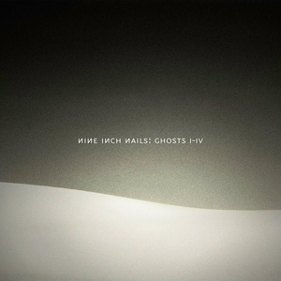
Notes:
NINE INCH NAILS – GHOSTS I-IV
- first release since leaving Interscope
- 36 instrumental tracks
- 4 EPs, 9 tracks on each
Ghosts I-IV was the first release from Trent Reznor after leaving Interscope.
It was a 36 track release, broken up into 4 EPs with 9 instrumental tracks on each. They are labeled Ghosts I, II, III and IV respectively with tracks being demarcated only by their track listing, position, and album art.
Ghosts was released for download from the Nine Inch Nails website where the physical album in a number of options could also be purchased. Both the downloadable files and the CD were released
Album artwork: Cover art of Ghosts I-IV by Nine Inch Nails, http://ghosts.nin.com. Available under a Creative Commons Attribution-Noncommercial-Share Alike 3.0 United States licence. Full terms available at http://creativecommons.org/licenses/by-nc-sa/3.0/us

Slide 76
Notes:
NINE INCH NAILS – GHOSTS I-IV
- released under a Creative Commons Attribution-Noncommercial-Share Alike 3.0 United States licence
under a Creative Commons Attribution-Noncommercial-Share Alike 3.0 United States licence, giving users the right to
Album artwork: Cover art of Ghosts I-IV by Nine Inch Nails, http://ghosts.nin.com. Available under a Creative Commons Attribution-Noncommercial-Share Alike 3.0 United States licence. Full terms available at http://creativecommons.org/licenses/by-nc-sa/3.0/us
Icons: The Pink CC logo is a derivative work of the CC logo by Creative Commons Corporation. The Pink Attribution icon, the Pink Noncommercial icon and the Pink Share Alike icon are derivative works of the Attribution element icon, the Noncommercial element icon and the Share Alike element icon by Creative Commons Corporation. The original logo and element icons are available under a Creative Commons Attribution 3.0 Unported licence. Full terms are available at http:// creativecommons.org/licenses/by/3.0. The original logo and element icons are available for reuse in accordance with the Creative Commons trademark policy available at http:// creativecommons.org/presskit. The Pink CC logo, the Pink Attribution icon, the Pink Noncommercial icon and the Pink Share Alike icon by Elliott Bledsoe are available under a Creative Commons Attribution 2.5 Australia licence. Full terms are available at http:// creativecommons.org/licenses/by/2.5/au

Slide 77
Notes:
NINE INCH NAILS – GHOSTS I-IV
- released under a Creative Commons Attribution-Noncommercial-Share Alike 3.0 United States licence
- distribute and remix for noncommercial purposes
distribute and remix the tracks for noncommercial purposes.
One of the options was a free download
Album artwork: Cover art of Ghosts I-IV by Nine Inch Nails, http://ghosts.nin.com. Available under a Creative Commons Attribution-Noncommercial-Share Alike 3.0 United States licence. Full terms available at http://creativecommons.org/licenses/by-nc-sa/3.0/us
Icons: The Pink Noncommercial icon is a derivative work of the Noncommercial element icon by Creative Commons Corporation. The original element icon is available under a Creative Commons Attribution 3.0 Unported licence. Full terms are available at http:// creativecommons.org/licenses/by/3.0. The icon is available for reuse in accordance with the Creative Commons trademark policy available at http:// creativecommons.org/presskit. The Pink Noncommercial icon by Elliott Bledsoe are available under a Creative Commons Attribution 2.5 Australia licence. Full terms are available at http:// creativecommons.org/licenses/by/2.5/au

Slide 78
Ghosts I
1 Ghosts I
2 Ghosts I
3 Ghosts I
4 Ghosts I
5 Ghosts I
6 Ghosts I
7 Ghosts I
8 Ghosts I
9 Ghosts I
Ghosts II
10 Ghosts II
11 Ghosts II
12 Ghosts II
13 Ghosts II
14 Ghosts II
15 Ghosts II
16 Ghosts II
17 Ghosts II
18 Ghosts II
Ghosts III
19 Ghosts III
20 Ghosts III
21 Ghosts III
22 Ghosts III
23 Ghosts III
24 Ghosts III
25 Ghosts III
26 Ghosts III
27 Ghosts III
Ghosts IV
28 Ghosts IV
29 Ghosts IV
30 Ghosts IV
31 Ghosts IV
32 Ghosts IV
33 Ghosts IV
34 Ghosts IV
35 Ghosts IV
36 Ghosts IV
Notes:
NINE INCH NAILS – GHOSTS I-IV
- free download of Ghosts I
of the first 9 tracks (Ghosts I in other words), available in MP3 format.
Album artwork: Cover art of Ghosts I-IV by Nine Inch Nails, http://ghosts.nin.com. Available under a Creative Commons Attribution-Noncommercial-Share Alike 3.0 United States licence. Full terms available at http://creativecommons.org/licenses/by-nc-sa/3.0/us
Icons: The Pink CC logo is a derivative work of the CC logo by Creative Commons Corporation. The Pink Attribution icon, the Pink Noncommercial icon and the Pink Share Alike icon are derivative works of the Attribution element icon, the Noncommercial element icon and the Share Alike element icon by Creative Commons Corporation. The original logo and element icons are available under a Creative Commons Attribution 3.0 Unported licence. Full terms are available at http:// creativecommons.org/licenses/by/3.0. The original logo and element icons are available for reuse in accordance with the Creative Commons trademark policy available at http:// creativecommons.org/presskit. The Pink CC logo, the Pink Attribution icon, the Pink Noncommercial icon and the Pink Share Alike icon by Elliott Bledsoe are available under a Creative Commons Attribution 2.5 Australia licence. Full terms are available at http:// creativecommons.org/licenses/by/2.5/au

Slide 79
Ghosts I
1 Ghosts I
2 Ghosts I
3 Ghosts I
4 Ghosts I
5 Ghosts I
6 Ghosts I
7 Ghosts I
8 Ghosts I
9 Ghosts I
Ghosts II
10 Ghosts II
11 Ghosts II
12 Ghosts II
13 Ghosts II
14 Ghosts II
15 Ghosts II
16 Ghosts II
17 Ghosts II
18 Ghosts II
Ghosts III
19 Ghosts III
20 Ghosts III
21 Ghosts III
22 Ghosts III
23 Ghosts III
24 Ghosts III
25 Ghosts III
26 Ghosts III
27 Ghosts III
Ghosts IV
28 Ghosts IV
29 Ghosts IV
30 Ghosts IV
31 Ghosts IV
32 Ghosts IV
33 Ghosts IV
34 Ghosts IV
35 Ghosts IV
36 Ghosts IV
Notes:
NINE INCH NAILS – GHOSTS I-IV
- all tracks under the licence
But of course, the entire album is under the licence, meaning if you purchase the CD then you are free to distribute and remix all of the tracks for noncommercial purposes.
3 months later and Trent Reznor continued his challenge to traditional music distribution and sales with the release
Album artwork: Cover art of Ghosts I-IV by Nine Inch Nails, http://ghosts.nin.com. Available under a Creative Commons Attribution-Noncommercial-Share Alike 3.0 United States licence. Full terms available at http://creativecommons.org/licenses/by-nc-sa/3.0/us
Icons: The Pink CC logo is a derivative work of the CC logo by Creative Commons Corporation. The Pink Attribution icon, the Pink Noncommercial icon and the Pink Share Alike icon are derivative works of the Attribution element icon, the Noncommercial element icon and the Share Alike element icon by Creative Commons Corporation. The original logo and element icons are available under a Creative Commons Attribution 3.0 Unported licence. Full terms are available at http:// creativecommons.org/licenses/by/3.0. The original logo and element icons are available for reuse in accordance with the Creative Commons trademark policy available at http:// creativecommons.org/presskit. The Pink CC logo, the Pink Attribution icon, the Pink Noncommercial icon and the Pink Share Alike icon by Elliott Bledsoe are available under a Creative Commons Attribution 2.5 Australia licence. Full terms are available at http:// creativecommons.org/licenses/by/2.5/au

Slide 80
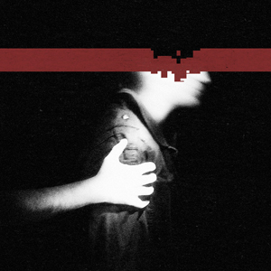
Notes:
NINE INCH NAILS – THE SLIP
- The Slip released 5 May
their seventh studio album, The Slip on 5 May. This time the entire album was available for download from the Nine Inch Nails website
Album artwork: Cover art of The Slip by Nine Inch Nails, http://theslip.nin.com. Available under a Creative Commons Attribution-Noncommercial-Share Alike 3.0 United States licence. Full terms available at http://creativecommons.org/licenses/by-nc-sa/3.0/us

Slide 81
Notes:
NINE INCH NAILS – THE SLIP
- under a Creative Commons Attribution-Noncommercial-Share Alike 3.0 United States licence
under a a Creative Commons Attribution-Noncommercial-Share Alike 3.0 United States licence.
Album artwork: Cover art of The Slip by Nine Inch Nails, http://theslip.nin.com. Available under a Creative Commons Attribution-Noncommercial-Share Alike 3.0 United States licence. Full terms available at http://creativecommons.org/licenses/by-nc-sa/3.0/us
Icons: The Pink CC logo is a derivative work of the CC logo by Creative Commons Corporation. The Pink Attribution icon, the Pink Noncommercial icon and the Pink Share Alike icon are derivative works of the Attribution element icon, the Noncommercial element icon and the Share Alike element icon by Creative Commons Corporation. The original logo and element icons are available under a Creative Commons Attribution 3.0 Unported licence. Full terms are available at http:// creativecommons.org/licenses/by/3.0. The original logo and element icons are available for reuse in accordance with the Creative Commons trademark policy available at http:// creativecommons.org/presskit. The Pink CC logo, the Pink Attribution icon, the Pink Noncommercial icon and the Pink Share Alike icon by Elliott Bledsoe are available under a Creative Commons Attribution 2.5 Australia licence. Full terms are available at http:// creativecommons.org/licenses/by/2.5/au

Slide 82
Notes:
NINE INCH NAILS – THE SLIP
- distribute and remix for noncommercial purposes
Again, this means that the tracks are available for distribution and remixing by users as long as they aren’t making financial gain out of the reuse.
Album artwork: Cover art of The Slip by Nine Inch Nails, http://theslip.nin.com. Available under a Creative Commons Attribution-Noncommercial-Share Alike 3.0 United States licence. Full terms available at http://creativecommons.org/licenses/by-nc-sa/3.0/us
Icons: The Pink Noncommercial icon is a derivative work of the Noncommercial element icon by Creative Commons Corporation. The original element icon is available under a Creative Commons Attribution 3.0 Unported licence. Full terms are available at http:// creativecommons.org/licenses/by/3.0. The icon is available for reuse in accordance with the Creative Commons trademark policy available at http:// creativecommons.org/presskit. The Pink Noncommercial icon by Elliott Bledsoe are available under a Creative Commons Attribution 2.5 Australia licence. Full terms are available at http:// creativecommons.org/licenses/by/2.5/au

Slide 83
Notes:
NINE INCH NAILS – NONCOMMERCIAL LICENSING
- NC does not mean no commercialisation
The beauty of the Noncommercial element is that you are not restricted from
Icons: The Pink Noncommercial icon is a derivative work of the Noncommercial element icon by Creative Commons Corporation. The original element icon is available under a Creative Commons Attribution 3.0 Unported licence. Full terms are available at http:// creativecommons.org/licenses/by/3.0. The icon is available for reuse in accordance with the Creative Commons trademark policy available at http:// creativecommons.org/presskit. The Pink Noncommercial icon by Elliott Bledsoe are available under a Creative Commons Attribution 2.5 Australia licence. Full terms are available at http:// creativecommons.org/licenses/by/2.5/au

Slide 84

Notes:
NINE INCH NAILS – NON/COMMERCIAL LICENSING
- NC does not mean no commercialisation
commercialising the same content. Both Ghosts I-IV and The Slip are business models that simultaneously merge the expectations of users and the functionality of new technologies with the need to make a living.
Icons: The Blue Commercial icon, is a derivative work of the Noncommercial element icon by Creative Commons Corporation. The original element icon is available under a Creative Commons Attribution 3.0 Unported licence. Full terms are available at http:// creativecommons.org/licenses/by/3.0. The element icon is available for reuse in accordance with the Creative Commons trademark policy available at http:// creativecommons.org/presskit. The Blue Commercial icon by Elliott Bledsoe are available under a Creative Commons Attribution 2.5 Australia licence. Full terms are available at http:// creativecommons.org/licenses/by/2.5/au

Slide 85
Notes:
NINE INCH NAILS – GHOSTS I-IV – BUSINESS MODEL
- released under a Creative Commons Attribution-Noncommercial-Share Alike 3.0 United States licence
Ghosts I-IV experimented with releasing a sample of the produce for noncommercial use while making
Album artwork: Cover art of Ghosts I-IV by Nine Inch Nails, http://ghosts.nin.com. Available under a Creative Commons Attribution-Noncommercial-Share Alike 3.0 United States licence. Full terms available at http://creativecommons.org/licenses/by-nc-sa/3.0/us
Icons: The Pink CC logo is a derivative work of the CC logo by Creative Commons Corporation. The Pink Attribution icon, the Pink Noncommercial icon and the Pink Share Alike icon are derivative works of the Attribution element icon, the Noncommercial element icon and the Share Alike element icon by Creative Commons Corporation. The original logo and element icons are available under a Creative Commons Attribution 3.0 Unported licence. Full terms are available at http:// creativecommons.org/licenses/by/3.0. The original logo and element icons are available for reuse in accordance with the Creative Commons trademark policy available at http:// creativecommons.org/presskit. The Pink CC logo, the Pink Attribution icon, the Pink Noncommercial icon and the Pink Share Alike icon by Elliott Bledsoe are available under a Creative Commons Attribution 2.5 Australia licence. Full terms are available at http:// creativecommons.org/licenses/by/2.5/au

Slide 86
Notes:
NINE INCH NAILS – GHOSTS I-IV – BUSINESS MODEL
- released under a Creative Commons Attribution-Noncommercial-Share Alike 3.0 United States licence
the remainder of the product available on a variable pricing scale.
Album artwork: Cover art of Ghosts I-IV by Nine Inch Nails, http://ghosts.nin.com. Available under a Creative Commons Attribution-Noncommercial-Share Alike 3.0 United States licence. Full terms available at http://creativecommons.org/licenses/by-nc-sa/3.0/us
Icons: The Blue Commercial icon is a derivative work of the Noncommercial element icon by Creative Commons Corporation. The original icon is available under a Creative Commons Attribution 3.0 Unported licence. Full terms are available at http:// creativecommons.org/licenses/by/3.0. These icons are available for reuse in accordance with the Creative Commons trademark policy available at http:// creativecommons.org/presskit. The Blue Commercial icon by Elliott Bledsoe is available under a Creative Commons Attribution 2.5 Australia licence. Full terms are available at http:// creativecommons.org/licenses/by/2.5/au

Slide 87
Notes:
NINE INCH NAILS – GHOSTS I-IV – BUSINESS MODEL
- released under a Creative Commons Attribution-Noncommercial-Share Alike 3.0 United States licence
- distribute and remix for noncommercial purposes
The tracks may be distributable and remixable for noncommercial purposes,
Album artwork: Cover art of Ghosts I-IV by Nine Inch Nails, http://ghosts.nin.com. Available under a Creative Commons Attribution-Noncommercial-Share Alike 3.0 United States licence. Full terms available at http://creativecommons.org/licenses/by-nc-sa/3.0/us
Icons: The Pink Noncommercial icon is a derivative work of the Noncommercial element icon by Creative Commons Corporation. The original element icon is available under a Creative Commons Attribution 3.0 Unported licence. Full terms are available at http:// creativecommons.org/licenses/by/3.0. The icon is available for reuse in accordance with the Creative Commons trademark policy available at http:// creativecommons.org/presskit. The Pink Noncommercial icon by Elliott Bledsoe are available under a Creative Commons Attribution 2.5 Australia licence. Full terms are available at http:// creativecommons.org/licenses/by/2.5/au

Slide 88
Notes:
NINE INCH NAILS – GHOSTS I-IV – BUSINESS MODEL
- NC does not mean no commercialisation
- 5 other packages
But to get the other tracks, at least initially, you had to buy them in one of the 5 other packages:
a $5 (USD) digital release of Ghosts I, II, III and IV (in other words all 36 tracks).
Purchasers were given a choice of 3 formats: bitrate MP3, Free Lossless Audio Codec (FLAC) or Apple Lossless. The last two formats are for music mixing software. All formats are released with no Digital Rights Management, meaning the files are able to be used with a number of platforms and software.
Album artwork: Cover art of Ghosts I-IV by Nine Inch Nails, http://ghosts.nin.com. Available under a Creative Commons Attribution-Noncommercial-Share Alike 3.0 United States licence. Full terms available at http://creativecommons.org/licenses/by-nc-sa/3.0/us
Icons: The Blue Commercial icon and the Pink Noncommercial icon are derivative works of the Noncommercial element icon by Creative Commons Corporation. The original icon is available under a Creative Commons Attribution 3.0 Unported licence. Full terms are available at http:// creativecommons.org/licenses/by/3.0. These icon is available for reuse in accordance with the Creative Commons trademark policy available at http:// creativecommons.org/presskit. The Blue Commercial icon and the Pink Noncommercial icon by Elliott Bledsoe is available under a Creative Commons Attribution 2.5 Australia licence. Full terms are available at http:// creativecommons.org/licenses/by/2.5/au

Slide 89
Notes:
NINE INCH NAILS – GHOSTS I-IV – BUSINESS MODEL
- NC does not mean no commercialisation
- 5 other packages
a 2 CD release with a 16 page booklet for $10 (USD);
Album artwork: Cover art of Ghosts I-IV by Nine Inch Nails, http://ghosts.nin.com. Available under a Creative Commons Attribution-Noncommercial-Share Alike 3.0 United States licence. Full terms available at http://creativecommons.org/licenses/by-nc-sa/3.0/us
Icons: The Blue Commercial icon and the Pink Noncommercial icon are derivative works of the Noncommercial element icon by Creative Commons Corporation. The original icon is available under a Creative Commons Attribution 3.0 Unported licence. Full terms are available at http:// creativecommons.org/licenses/by/3.0. These icon is available for reuse in accordance with the Creative Commons trademark policy available at http:// creativecommons.org/presskit. The Blue Commercial icon and the Pink Noncommercial icon by Elliott Bledsoe is available under a Creative Commons Attribution 2.5 Australia licence. Full terms are available at http:// creativecommons.org/licenses/by/2.5/au

Slide 90
Notes:
NINE INCH NAILS – GHOSTS I-IV – BUSINESS MODEL
- NC does not mean no commercialisation
- 5 other packages
a vinyl release for $39;
Album artwork: Cover art of Ghosts I-IV by Nine Inch Nails, http://ghosts.nin.com. Available under a Creative Commons Attribution-Noncommercial-Share Alike 3.0 United States licence. Full terms available at http://creativecommons.org/licenses/by-nc-sa/3.0/us
Icons: The Blue Commercial icon and the Pink Noncommercial icon are derivative works of the Noncommercial element icon by Creative Commons Corporation. The original icon is available under a Creative Commons Attribution 3.0 Unported licence. Full terms are available at http:// creativecommons.org/licenses/by/3.0. These icon is available for reuse in accordance with the Creative Commons trademark policy available at http:// creativecommons.org/presskit. The Blue Commercial icon and the Pink Noncommercial icon by Elliott Bledsoe is available under a Creative Commons Attribution 2.5 Australia licence. Full terms are available at http:// creativecommons.org/licenses/by/2.5/au

Slide 91
Notes:
NINE INCH NAILS – GHOSTS I-IV – BUSINESS MODEL
- NC does not mean no commercialisation
- 5 other packages
the deluxe edition which included the 2 CDs, a data DVD with multitrack files for use with audio editing software, a Blu-ray Disc with the album in high definition and a 48 page hard cover book at a cost of $75;
This edition also included immediate access to the digital downloads, again in a choice of bitrate MP3, FLAC of Apple Lossless formats with no DRM. And the final option was
Album artwork: Cover art of Ghosts I-IV by Nine Inch Nails, http://ghosts.nin.com. Available under a Creative Commons Attribution-Noncommercial-Share Alike 3.0 United States licence. Full terms available at http://creativecommons.org/licenses/by-nc-sa/3.0/us
Icons: The Blue Commercial icon and the Pink Noncommercial icon are derivative works of the Noncommercial element icon by Creative Commons Corporation. The original icon is available under a Creative Commons Attribution 3.0 Unported licence. Full terms are available at http:// creativecommons.org/licenses/by/3.0. These icon is available for reuse in accordance with the Creative Commons trademark policy available at http:// creativecommons.org/presskit. The Blue Commercial icon and the Pink Noncommercial icon by Elliott Bledsoe is available under a Creative Commons Attribution 2.5 Australia licence. Full terms are available at http:// creativecommons.org/licenses/by/2.5/au

Slide 92
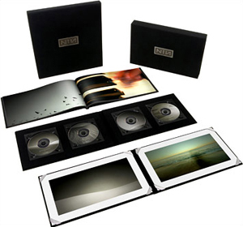
Notes:
NINE INCH NAILS – THE SLIP – BUSINESS MODEL– ULTRA DELUXE EDITION
- ultra deluxe edition
the very decedent ultra deluxe edition which included everything in the deluxe edition as well as the vinyl in a special edition fabric slipcase, and two limited edition prints, unique to each set.
There were only 2500 of this edition, all signed and numbered by Trent Reznor, and retailed for $300 a set. This edition

Slide 93
sold out 24 hours
Notes:
NINE INCH NAILS – GHOSTS I-IV – BUSINESS MODEL – ULTRA DELUXE EDITION
- ultra deluxe edition
sold out in 24 hours

Slide 94
$750 000 (USD)
Notes:
NINE INCH NAILS – GHOSTS I-IV – BUSINESS MODEL – ULTRA DELUXE EDITION
- ultra deluxe edition
and grossed $750 000.

Slide 95
781 917 transactions
Notes:
NINE INCH NAILS – GHOSTS I-IV – BUSINESS MODEL
- 780 000+ transactions total, including free downloads
In the first week of release, over 800 000 transactions were processed via the Nine Inch Nails website, grossing the band

Slide 96
$1.6 million (USD)
Notes:
NINE INCH NAILS – GHOSTS I-IV – BUSINESS MODEL
- $1.6 million+ (USD) in the first week
$1 619 420 (USD) in the first week.
Source: Van Buskirk, E “Nine Inch Nails Album Generated $1.6 Million in the First Week (Updated)” on WIRED, http://blog.wired.com/music/2008/03/nine-inch-nai-2.html

Slide 97
Notes:
NINE INCH NAILS – THE SLIP – BUSINESS MODEL
With The Slip Trent Reznor again experimented with a new approach to selling and distributing the album. Unlike Ghosts I-IV,
Album artwork: Cover art of The Slip by Nine Inch Nails, http://theslip.nin.com. Available under a Creative Commons Attribution-Noncommercial-Share Alike 3.0 United States licence. Full terms available at http://creativecommons.org/licenses/by-nc-sa/3.0/u

Slide 98
The Slip
999,999
1,000,000
Letting You
Discipline
Echoplex
Head Down
Lights in the Sky
Corona Radiata
The Four of Us Are Dying
Demon Seed
Notes:
NINE INCH NAILS – THE SLIP – BUSINESS MODEL
- whole album released under licence
- released under a Creative Commons Attribution-Noncommercial-Share Alike 3.0 United States licence
All the tracks on The Slip were released for free under a Creative Commons Attribution-Noncommercial-Share Alike 3.0 United States.
Album artwork: Cover art of The Slip by Nine Inch Nails, http://theslip.nin.com. Available under a Creative Commons Attribution-Noncommercial-Share Alike 3.0 United States licence. Full terms available at http://creativecommons.org/licenses/by-nc-sa/3.0/us

Slide 99
The Slip
999,999
1,000,000
Letting You
Discipline
Echoplex
Head Down
Lights in the Sky
Corona Radiata
The Four of Us Are Dying
Demon Seed
Notes:
NINE INCH NAILS – THE SLIP – BUSINESS MODEL
- whole album released under licence
- released under a Creative Commons Attribution-Noncommercial-Share Alike 3.0 United States licence
All the tracks on The Slip were released for free under a Creative Commons Attribution-Noncommercial-Share Alike 3.0 United States. This time, the free download gave users 5 format options: MP3 and WAVE and FLAC, FLAC high definition and Apple Lossless formats for mixing. The last three formats were available torrent files for use with peer-to-peer networks. Again, all files are DRM free.
Album artwork: Cover art of The Slip by Nine Inch Nails, http://theslip.nin.com. Available under a Creative Commons Attribution-Noncommercial-Share Alike 3.0 United States licence. Full terms available at http://creativecommons.org/licenses/by-nc-sa/3.0/us
Icons: The Pink CC logo is a derivative work of the CC logo by Creative Commons Corporation. The Pink Attribution icon, the Pink Noncommercial icon and the Pink Share Alike icon are derivative works of the Attribution element icon, the Noncommercial element icon and the Share Alike element icon by Creative Commons Corporation. The original logo and element icons are available under a Creative Commons Attribution 3.0 Unported licence. Full terms are available at http:// creativecommons.org/licenses/by/3.0. The original logo and element icons are available for reuse in accordance with the Creative Commons trademark policy available at http:// creativecommons.org/presskit. The Pink CC logo, the Pink Attribution icon, the Pink Noncommercial icon and the Pink Share Alike icon by Elliott Bledsoe are available under a Creative Commons Attribution 2.5 Australia licence. Full terms are available at http:// creativecommons.org/licenses/by/2.5/au

Slide 100
Notes:
NINE INCH NAILS – THE SLIP – BUSINESS MODEL
- album commercially available through retail outlets
Nine Inch Nails also commercially released the album, but unlike Ghosts I-IV, The Slip was not available to purchase on www.nin.com.
Album artwork: Cover art of The Slip by Nine Inch Nails, http://theslip.nin.com. Available under a Creative Commons Attribution-Noncommercial-Share Alike 3.0 United States licence. Full terms available at http://creativecommons.org/licenses/by-nc-sa/3.0/us
Icons: The Blue Commercial icon is a derivative work of the Noncommercial element icon by Creative Commons Corporation. The original icon is available under a Creative Commons Attribution 3.0 Unported licence. Full terms are available at http:// creativecommons.org/licenses/by/3.0. These icons are available for reuse in accordance with the Creative Commons trademark policy available at http:// creativecommons.org/presskit. The Blue Commercial icon by Elliott Bledsoe is available under a Creative Commons Attribution 2.5 Australia licence. Full terms are available at http:// creativecommons.org/licenses/by/2.5/au

Slide 101
Notes:
NINE INCH NAILS – THE SLIP – BUSINESS MODEL
- album commercially available through retail outlets
Rather, the standard 2 CD and live DVD edition and the vinyl release were through retail outlets internationally. Both editions are limited to 250 000 only, each individually numbered. It hit shelves in Australia on 19 July this year.
Album artwork: Cover art of The Slip by Nine Inch Nails, http://theslip.nin.com. Available under a Creative Commons Attribution-Noncommercial-Share Alike 3.0 United States licence. Full terms available at http://creativecommons.org/licenses/by-nc-sa/3.0/us
Icons: The Blue Commercial icon and the Pink Noncommercial icon are derivative works of the Noncommercial element icon by Creative Commons Corporation. The original icon is available under a Creative Commons Attribution 3.0 Unported licence. Full terms are available at http:// creativecommons.org/licenses/by/3.0. These icon is available for reuse in accordance with the Creative Commons trademark policy available at http:// creativecommons.org/presskit. The Blue Commercial icon and the Pink Noncommercial icon by Elliott Bledsoe is available under a Creative Commons Attribution 2.5 Australia licence. Full terms are available at http:// creativecommons.org/licenses/by/2.5/au

Slide 102
cc links
CC Case Studies Wiki Project:
http://wiki.creativecommons.org/casestudies
Creative Commons:
http://creativecommons.org
Creative Commons international:
http://creativecommons.org/worldwide
Science Commons:
http://sciencecommons.org
ccLearn:
http://learn.creativecommons.org
Notes:
CLOSING – SUMMARY + RESOURCES
- business is changing
- ‘giving it away’ does not mean ‘no pay’
I hope that this presentation has given you a bit of an insight into some of the innovative uses of Creative Commons licences that are occurring in the Creative Industries. The way we create, share and utilise content has changed. And the way that we make a living from that content has changed. I hope that these case studies illustrate that ‘giving it away’ does not mean ‘no pay.’
If you are interested in more information about these case studies, and many more from around the world, please take a look at the Creative Commons Case Studies Wiki project, available at http://wiki.creativecommons.org/casestudies

Slide 103
make contact
Elliott Bledsoe
Project Officer
Creative Commons Australia
+61 7 3138 9597
0405059367
elliott@creativecommons.org.au
http://creativecommons.org.au
This presentation is available at:
http://creativecommons.org.au/cibusinessmodels
Notes:
CLOSING – CONTACTS
Thank you very much.
These are my contact details, please feel free to get in touch with me. If you want to go back and have a look at this presentation again, it is available at the web address listed here.

